Slide 1
Countability
CMSC 250

Slide 2
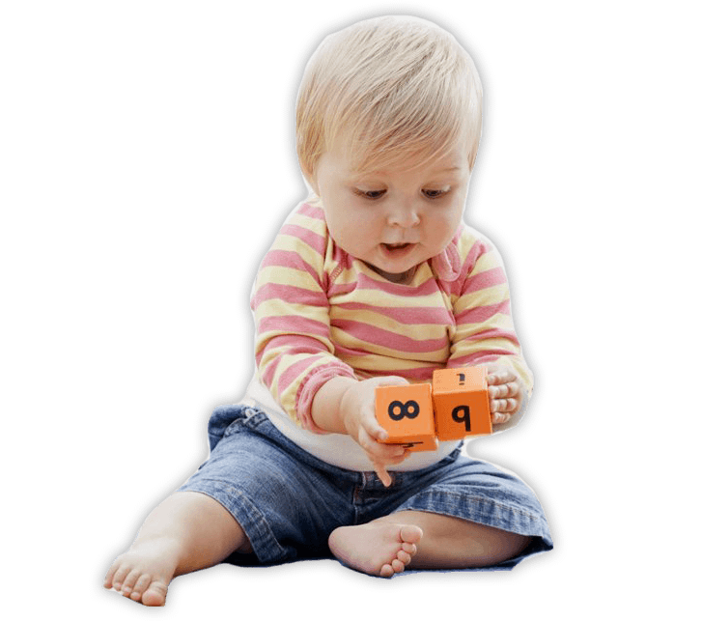

Motivation
Two toddlers want to compare their marbles to see who has more.
They cannot count yet.

Slide 3
Motivation
Two toddlers want to compare their marbles to see who has more.
They cannot count yet.
How do they find out who has more?

Slide 4
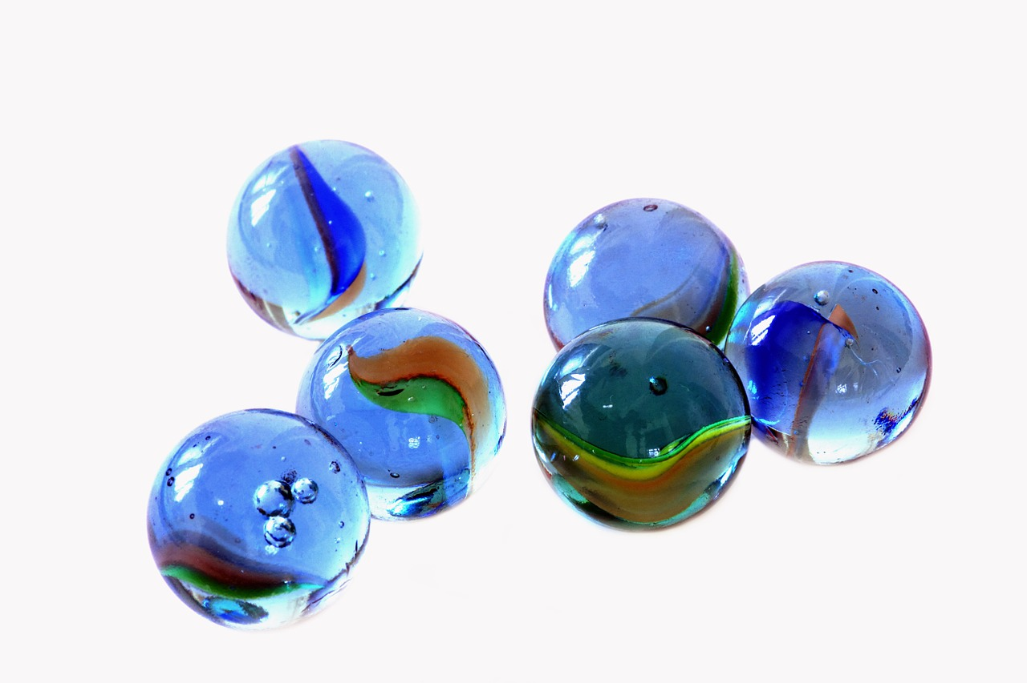

Motivation
They line them up and compare!

Slide 5
Motivation
They line them up and compare!

Slide 6
Motivation
They line them up and compare!
Intuition for us: If we can find such a mapping between two (infinite) sets, we will say that they have the same (infinite) cardinality (or size).

Slide 7
Motivation
This matching of marbles
Every two different marbles on left go to two different marbles on right
Every marble on right is matched by some marble on the left

Slide 8
Motivation
This matching of marbles
Every two different marbles on left go to two different marbles on right
Every marble on right is matched by some marble on the left
This is a bijection!
WE DEFINE TWO SETS TO BE THE SAME SIZE IF THERE IS A BIJECTION BETWEEN THEM.

Slide 9
Refresher on bijections

Slide 10
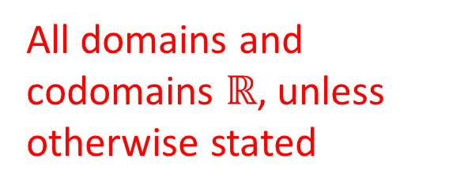
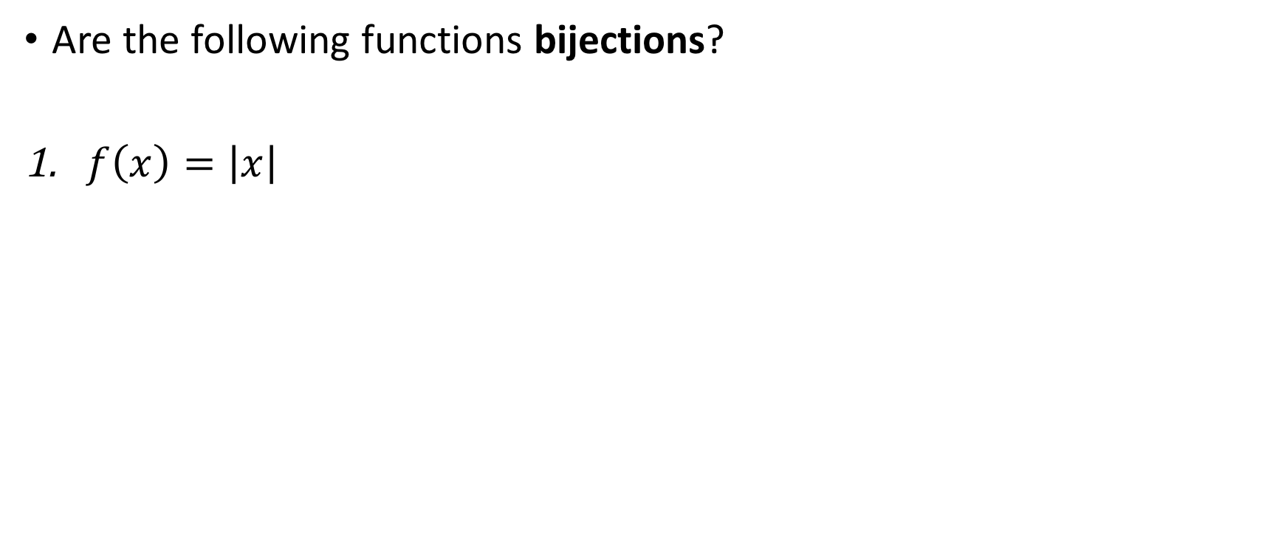
Refresher on bijections
All domains and codomains $ℝ$, unless otherwise stated
Yes
No
Are the following functions bijections?
$f\left(x\right)=\left|x\right|$

Slide 11
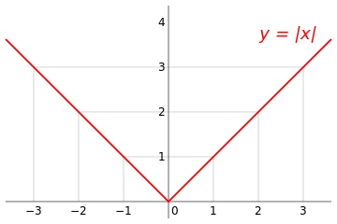
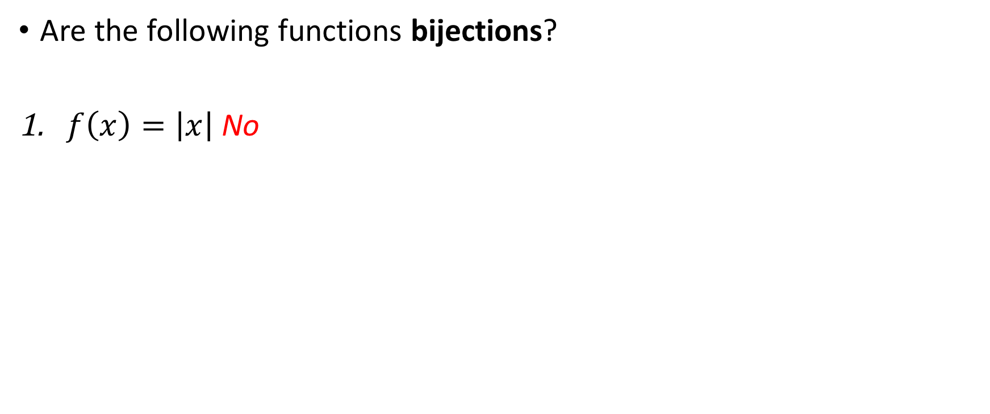
Quiz on bijections
All domains and codomains $ℝ$, unless otherwise stated
Yes
No
Are the following functions bijections?
$f\left(x\right)=\left|x\right|$ No
Non-injective!

Slide 12

Refresher on bijections
All domains and codomains $ℝ$, unless otherwise stated
Yes
No
Are the following functions bijections?
$f\left(x\right)=\left|x\right|$ No
$f\left(x\right)=a⋅x+b, b∈ℝ, a∈ℝ^{≠0}$

Slide 13
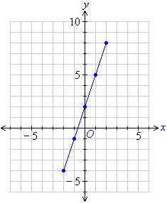
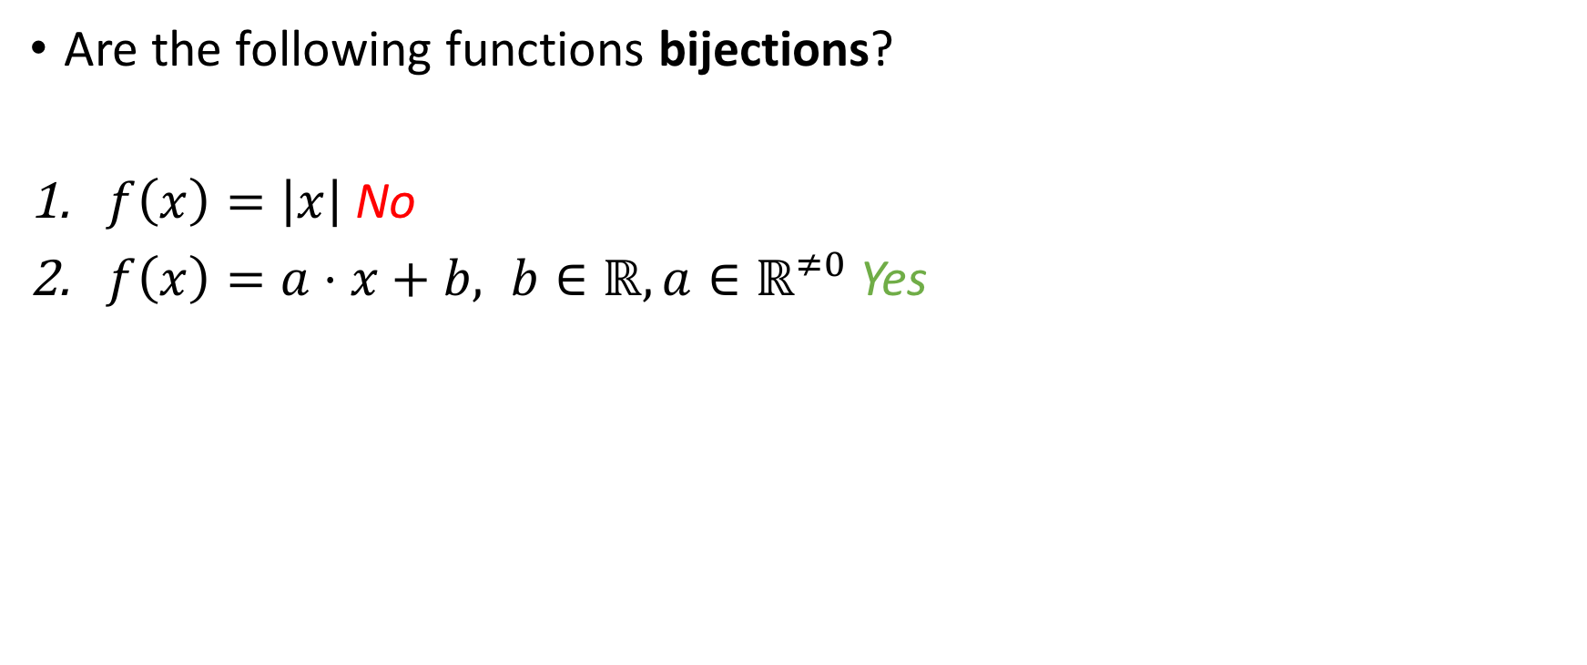
Refresher on bijections
All domains and codomains $ℝ$, unless otherwise stated
Yes
No
Are the following functions bijections?
$f\left(x\right)=\left|x\right|$ No
$f\left(x\right)=a⋅x+b, b∈ℝ, a∈ℝ^{≠0}$ Yes
Straight line in coordinate plane

Slide 14
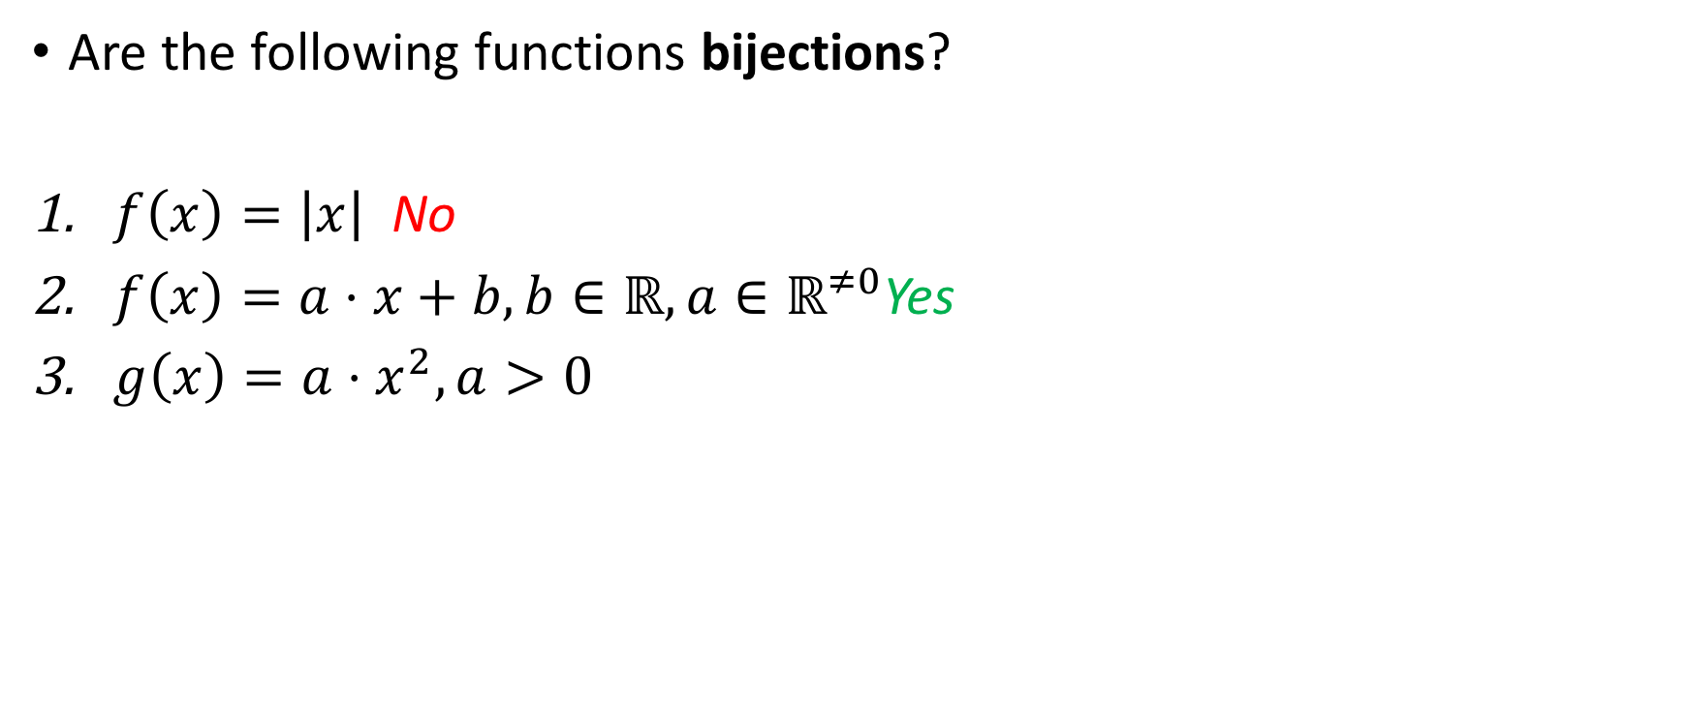
Refresher on bijections
All domains and codomains $ℝ$, unless otherwise stated
Yes
No
Are the following functions bijections?
$f\left(x\right)=\left|x\right|$ No
$f\left(x\right)=a⋅x+b,b∈ℝ, a∈ℝ^{≠0}$Yes
$g\left(x\right)={a⋅x}^{2}, a>0$

Slide 15
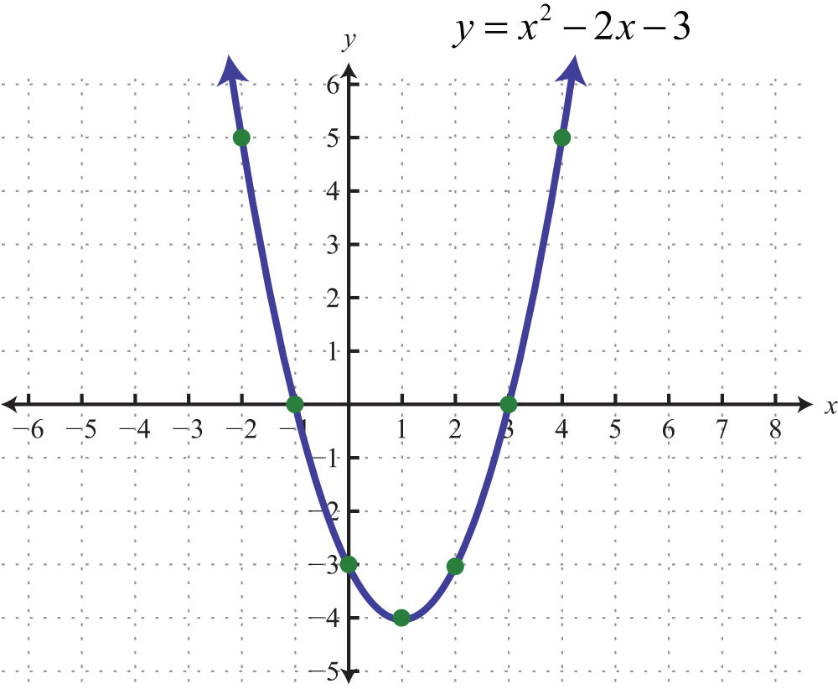
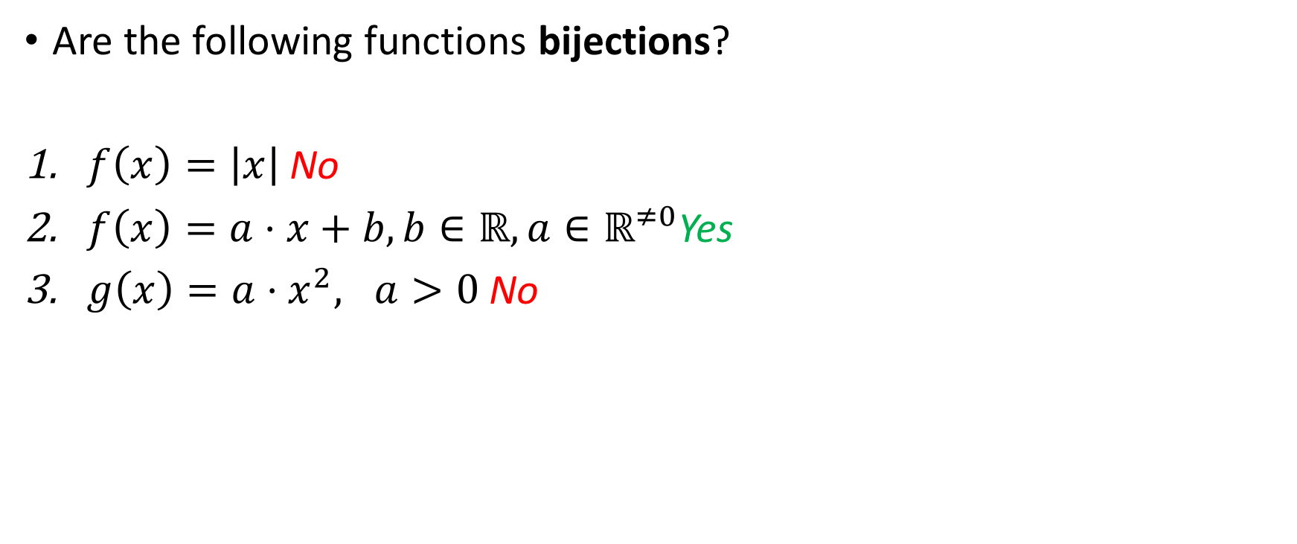
Refresher on bijections
All domains and codomains $ℝ$, unless otherwise stated
Yes
No
Are the following functions bijections?
$f\left(x\right)=\left|x\right|$No
$f\left(x\right)=a⋅x+b,b∈ℝ, a∈ℝ^{≠0}$Yes
$g\left(x\right)={a⋅x}^{2}, a>0$ No
Non-injective!

Slide 16
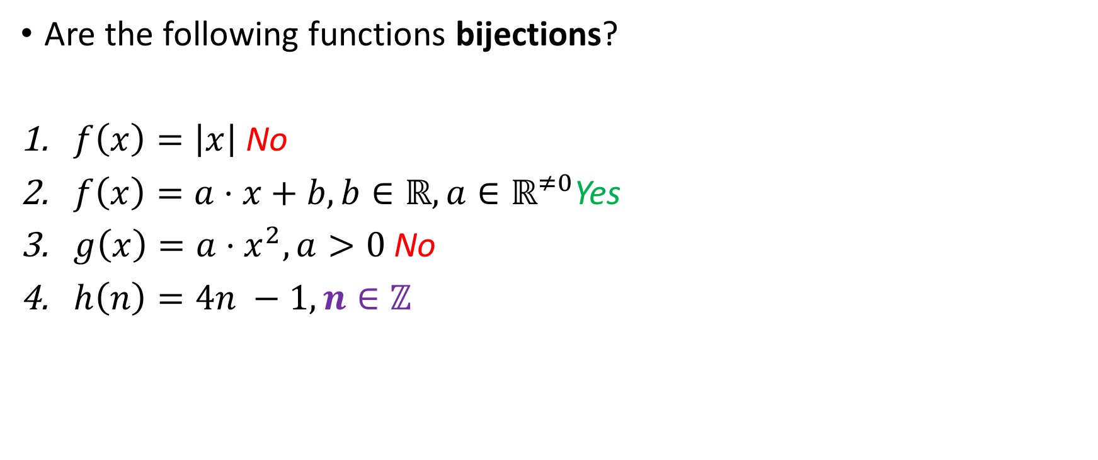
Refresher on bijections
All domains and codomains $ℝ$, unless otherwise stated
Yes
No
Are the following functions bijections?
$f\left(x\right)=\left|x\right|$ No
$f\left(x\right)=a⋅x+b,b∈ℝ, a∈ℝ^{≠0}$Yes
$g\left(x\right)={a⋅x}^{2}, a>0$ No
$h\left(n\right)=4n −1, n∈ℤ$

Slide 17
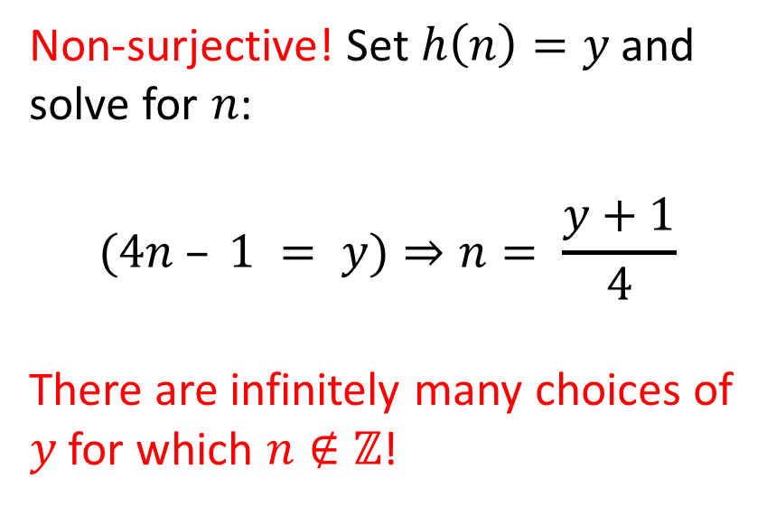
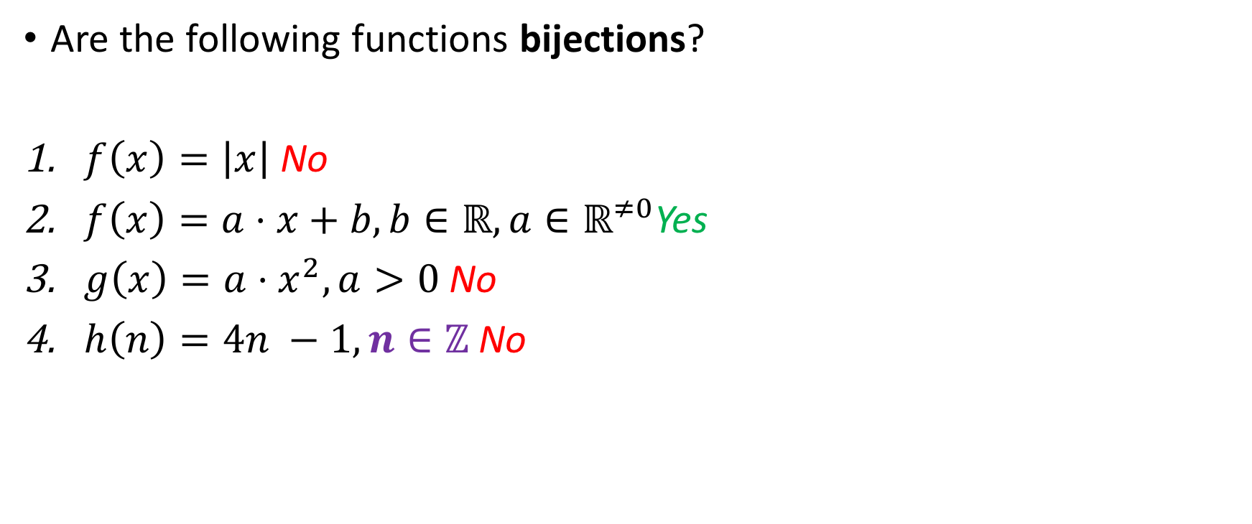
Refresher on bijections
All domains and codomains $ℝ$, unless otherwise stated
Yes
No
Are the following functions bijections?
$f\left(x\right)=\left|x\right|$ No
$f\left(x\right)=a⋅x+b,b∈ℝ, a∈ℝ^{≠0}$Yes
$g\left(x\right)={a⋅x}^{2}, a>0$ No
$h\left(n\right)=4n −1, n∈ℤ$ No
Non-surjective! Set $h\left(n\right)=y$ and solve for $n$:
$$(4n – 1 = y)⇒n= \frac{y+1}{4}$$
There are infinitely many choices of $y$ for which $n∉ℤ$!

Slide 18

Refresher on bijections
All domains and codomains $ℝ$, unless otherwise stated
Yes
No
Are the following functions bijections?
$f\left(x\right)=\left|x\right|$ No
$f\left(x\right)=a⋅x+b,b∈ℝ, a∈ℝ^{≠0}$Yes
$g\left(x\right)={a⋅x}^{2}, a>0$ No
$h\left(n\right)=4n −1, n∈ℤ$ No
$h\left(x\right)=4x −1, x∈ℝ$

Slide 19
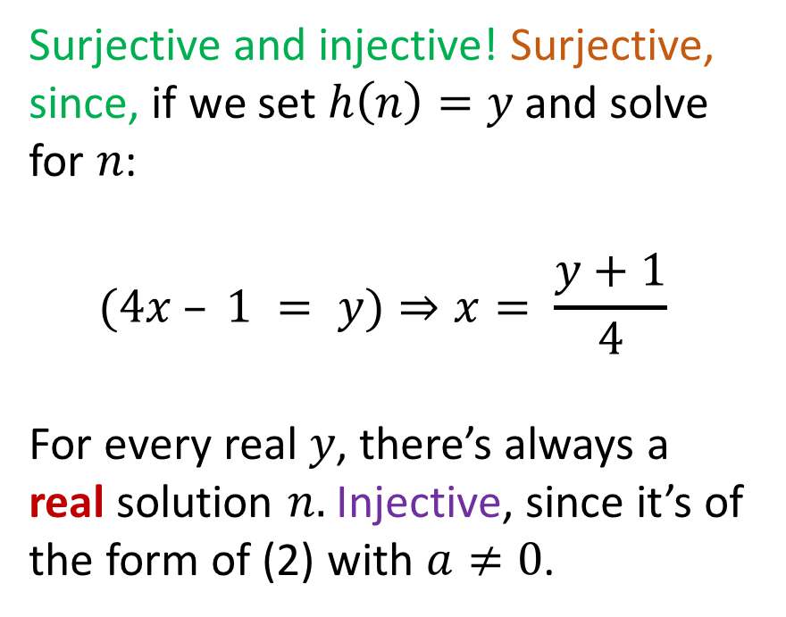
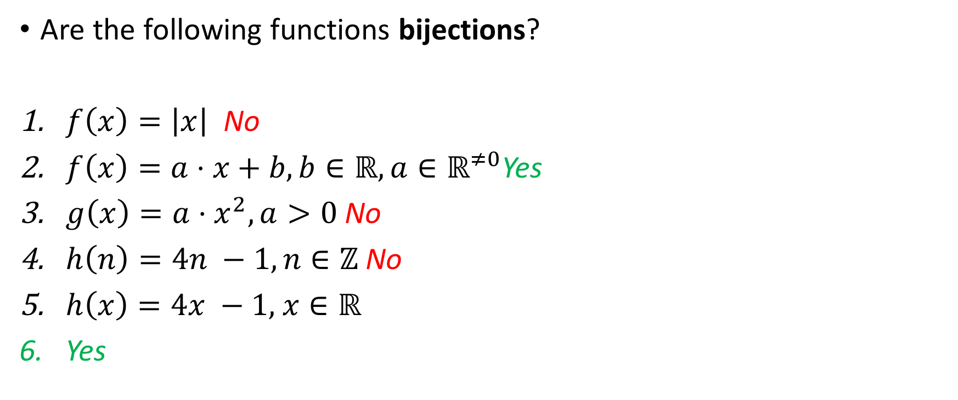
Refresher on bijections
All domains and codomains $ℝ$, unless otherwise stated
Yes
No
Are the following functions bijections?
$f\left(x\right)=\left|x\right|$ No
$f\left(x\right)=a⋅x+b,b∈ℝ, a∈ℝ^{≠0}$Yes
$g\left(x\right)={a⋅x}^{2}, a>0$ No
$h\left(n\right)=4n −1, n∈ℤ$ No
$h\left(x\right)=4x −1,$ $x∈ℝ$
Yes
Surjective and injective! Surjective, since, if we set $h\left(n\right)=y$ and solve for $n$:
$$(4x – 1 = y)⇒x= \frac{y+1}{4}$$
For every real $y$, there’s always a real solution $n.$ Injective, since it’s of the form of (2) with $a≠0$.

Slide 20
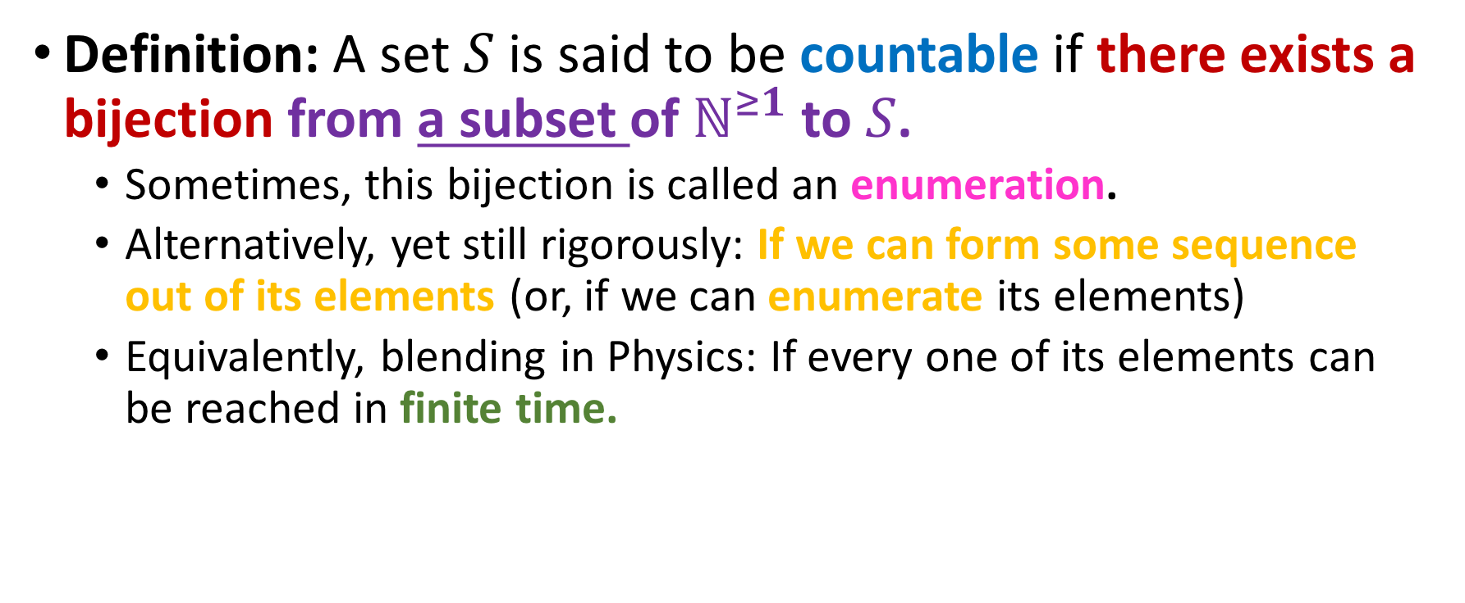
Countable sets
Definition: A set $S$ is said to be countable if there exists a bijection from a subset of $ℕ^{≥1}$ to $S$.
Sometimes, this bijection is called an enumeration.
Alternatively, yet still rigorously: If we can form some sequence out of its elements (or, if we can enumerate its elements)
Equivalently, blending in Physics: If every one of its elements can be reached in finite time.

Slide 21
Finite sets and countability
Every finite set is countable.

Slide 22
Finite sets and countability
Every finite set is countable.
Why?

Slide 23
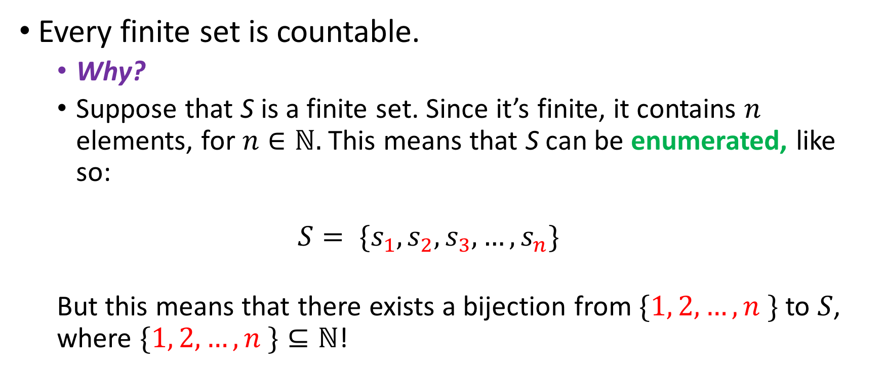
Finite sets and countability
Every finite set is countable.
Why?
Suppose that S is a finite set. Since it’s finite, it contains $n$ elements, for $n∈ℕ.$ This means that S can be enumerated, like so:
$$S= \{s_{1}, s_{2}, s_{3},…, s_{n}\}$$
But this means that there exists a bijection from $\{1, 2, …, n \}$ to $S$, where $\{1, 2, …, n \}⊆ℕ$!

Slide 24
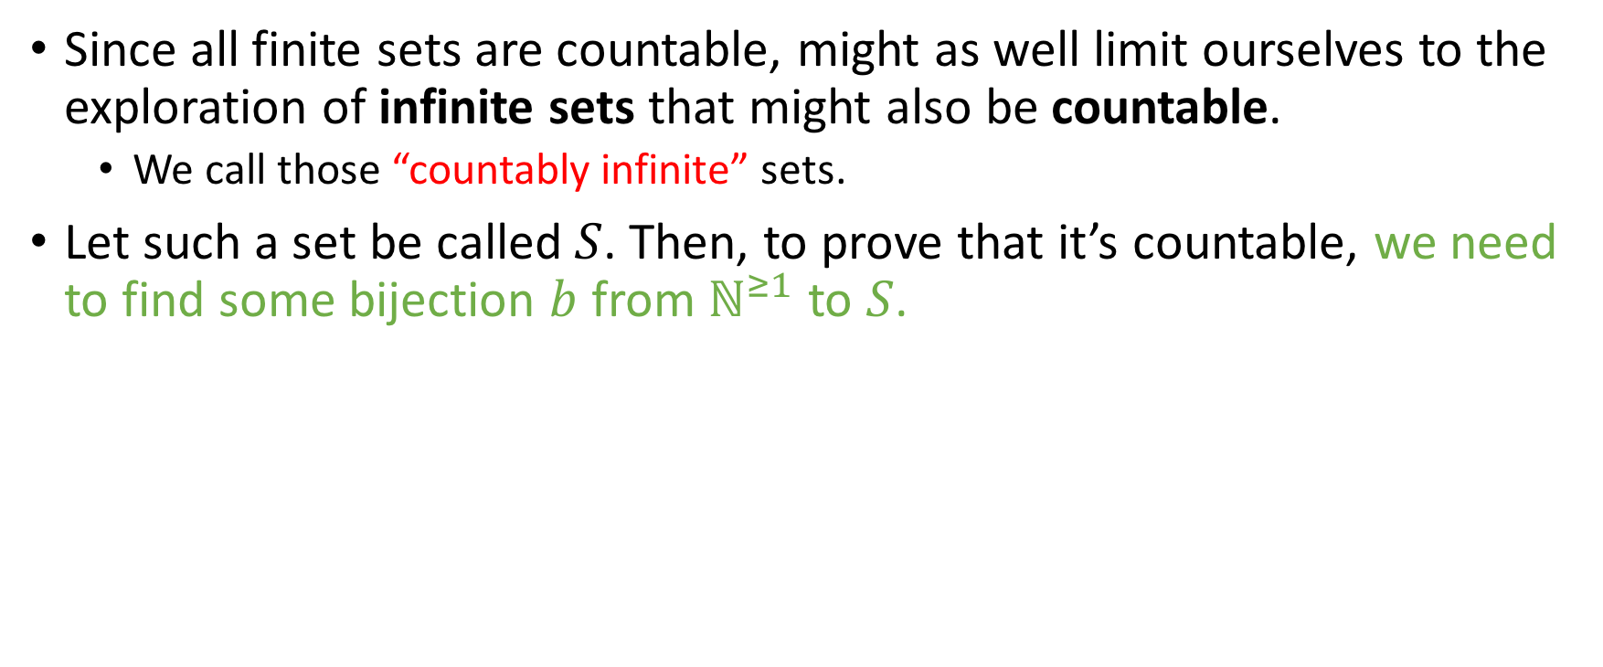
Infinite sets and countability
Since all finite sets are countable, might as well limit ourselves to the exploration of infinite sets that might also be countable.
We call those “countably infinite” sets.
Let such a set be called $S$. Then, to prove that it’s countable, we need to find some bijection $b$ from $ℕ^{≥1}$ to $S$.

Slide 25
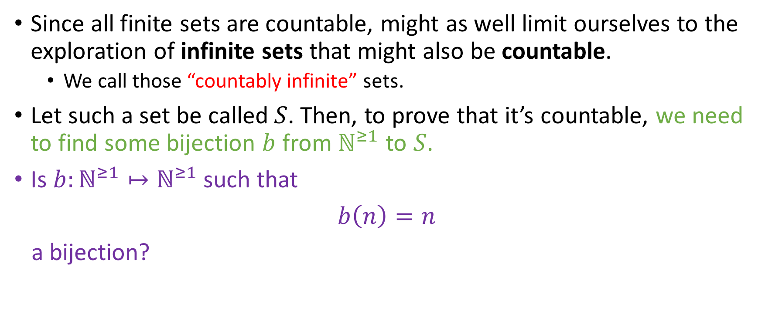
Infinite sets and countability
Since all finite sets are countable, might as well limit ourselves to the exploration of infinite sets that might also be countable.
We call those “countably infinite” sets.
Let such a set be called $S$. Then, to prove that it’s countable, we need to find some bijection $b$ from $ℕ^{≥1}$ to $S$.
Is $b:ℕ^{≥1}↦ℕ^{≥1}$ such that
$b\left(n\right)=n$
a bijection?
Yes
No

Slide 26
Infinite sets and countability
Since all finite sets are countable, might as well limit ourselves to the exploration of infinite sets that might also be countable.
We call those “countably infinite” sets.
Let such a set be called $S$. Then, to prove that it’s countable, we need to find some bijection $b$ from $ℕ^{≥1}$ to $S$.
Is $b:ℕ^{≥1}↦ℕ^{≥1}$ such that
$b\left(n\right)=n$
a bijection?
Yes
No

Slide 27
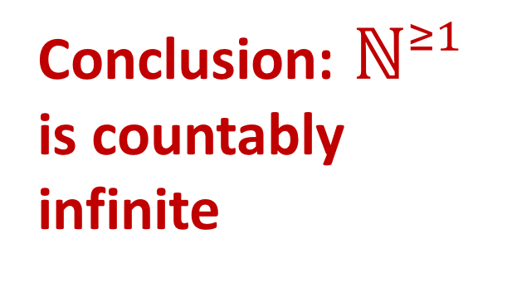
Infinite sets and countability
Since all finite sets are countable, might as well limit ourselves to the exploration of infinite sets that might also be countable.
We call those “countably infinite” sets.
Let such a set be called $S$. Then, to prove that it’s countable, we need to find some bijection $b$ from $ℕ^{≥1}$ to $S$.
Is $b:ℕ^{≥1}↦ℕ^{≥1}$ such that
$b\left(n\right)=n$
a bijection?
Conclusion:${ ℕ}^{≥1}$ is countably infinite
Yes
No

Slide 28
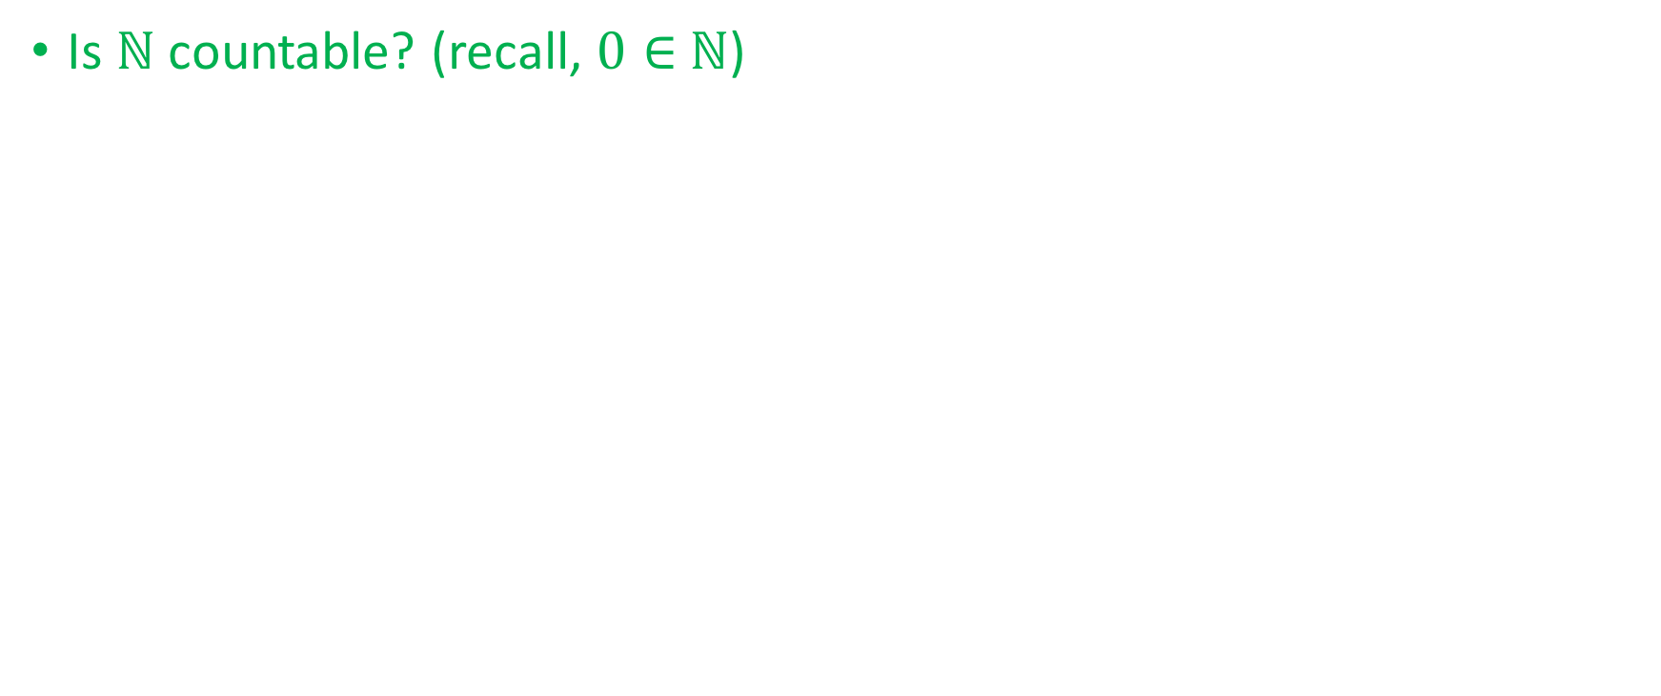

Countability of $ℕ$
Is $ℕ$ countable? (recall, $0∈$ $ℕ$)
Yes
No

Slide 29
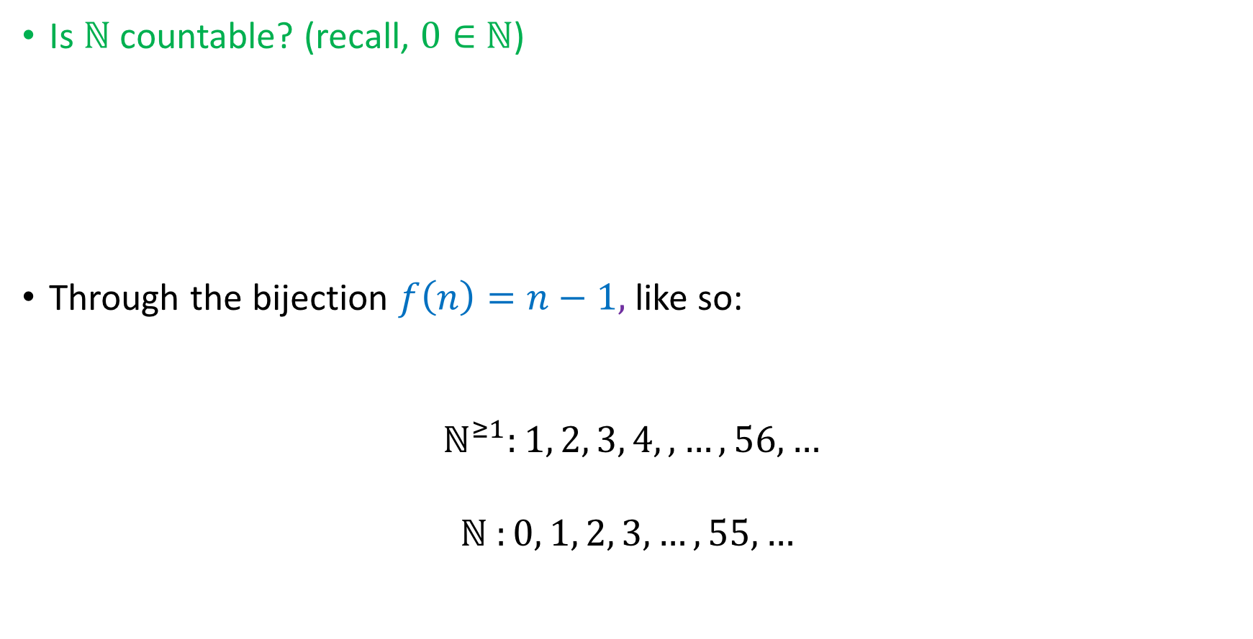

Countability of $ℕ$
Is $ℕ$ countable? (recall, $0∈$ $ℕ$)
Through the bijection $f\left(n\right)=n−1,$ like so:
$$ℕ^{≥1}:1, 2, 3, 4, , …,56, …$$
$$ℕ^{ }:0, 1, 2, 3,…, 55, …$$
Yes
No
$$f$$

Slide 30
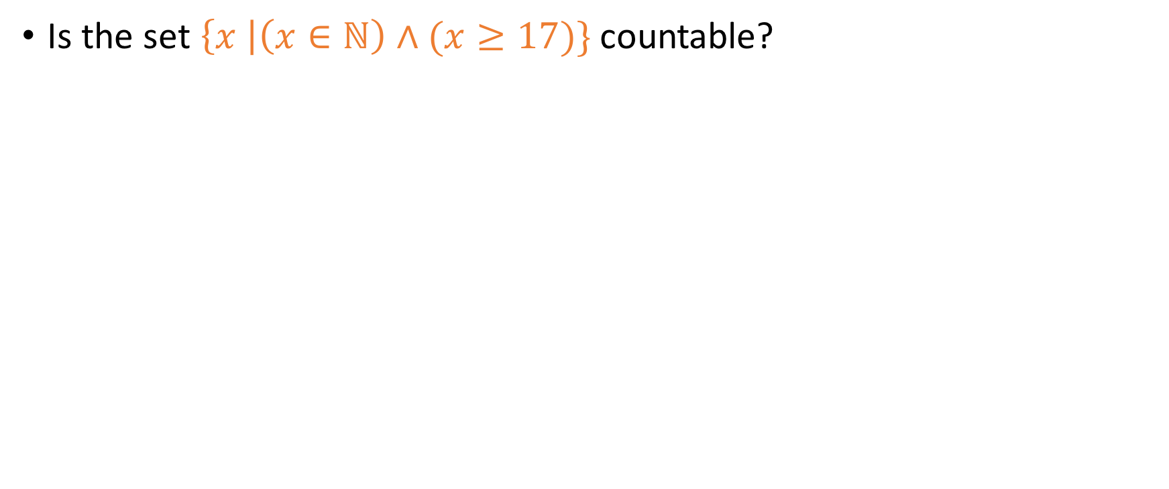

Countability of other $A⊆ℕ$
Is the set $\left\{x \right|\left(x∈ℕ\right)∧(x≥17)\}$ countable?
Yes
No

Slide 31
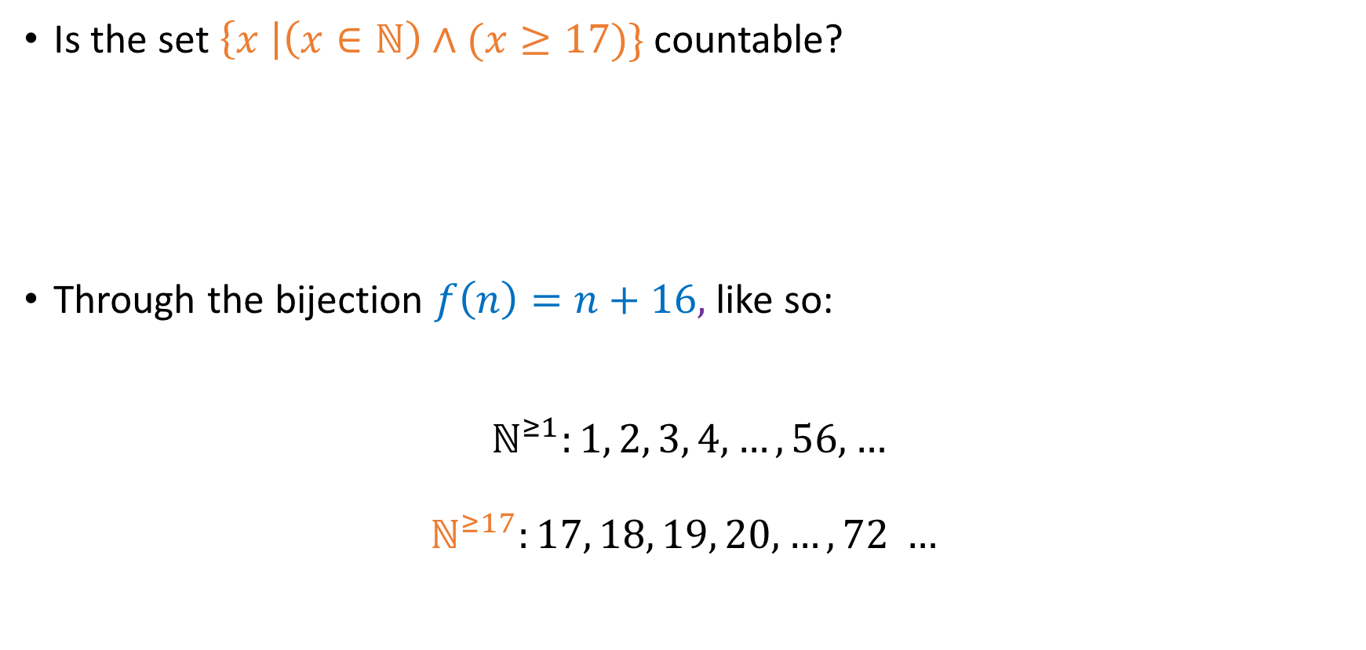
Countability of other $A⊆ℕ$
Is the set $\left\{x \right|\left(x∈ℕ\right)∧(x≥17)\}$ countable?
Through the bijection $f\left(n\right)=n+16,$ like so:
$$ℕ^{≥1}:1, 2, 3, 4, …, 56, …$$
$$ℕ^{≥17}:17, 18, 19, 20,…, 72 …$$
Yes
No
$$f$$

Slide 32
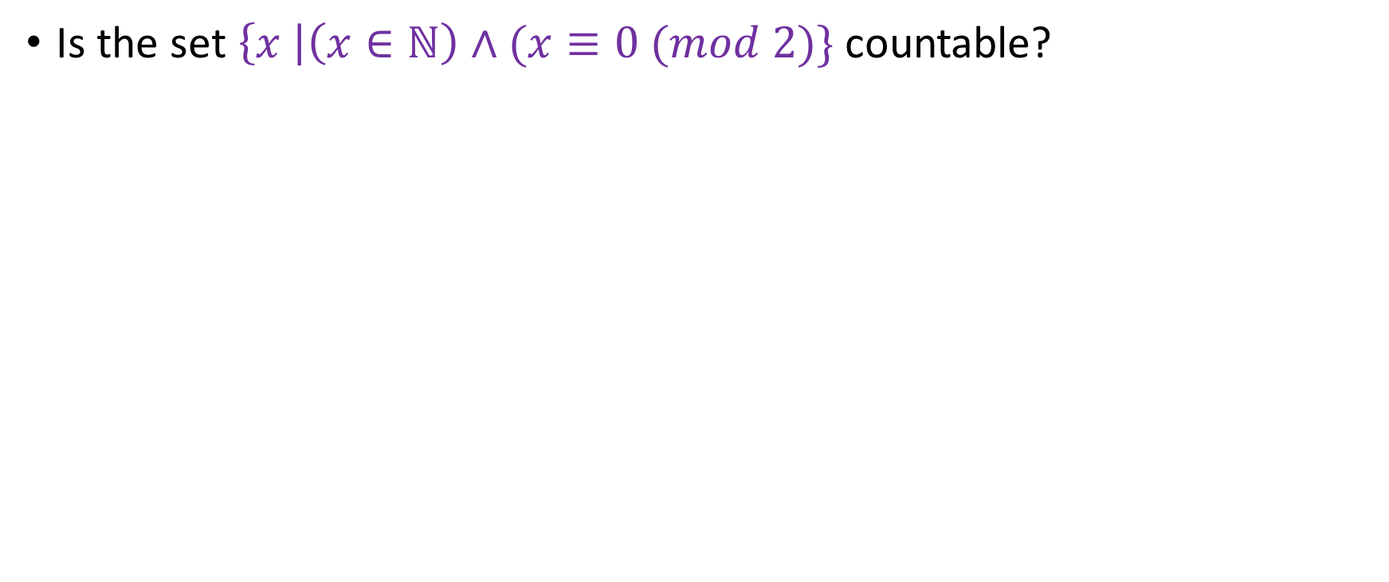
Countability of other $A⊆ℕ$
Is the set $\left\{x \right|\left(x∈ℕ\right)∧(x≡0 (mod 2)\}$ countable?
Yes
No

Slide 33
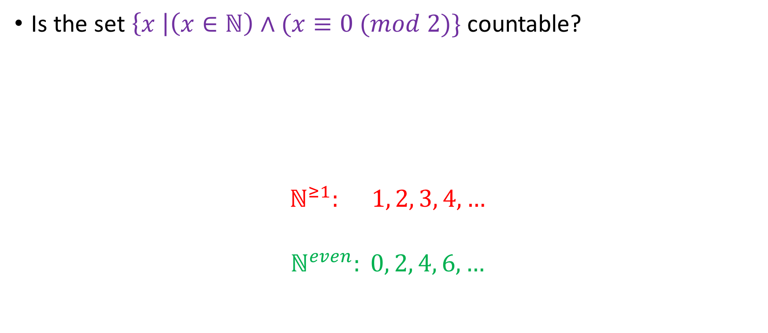
Countability of other $A⊆ℕ$
Is the set $\left\{x \right|\left(x∈ℕ\right)∧(x≡0 (mod 2)\}$ countable?
$$ℕ^{≥1}: 1, 2, 3, 4, …$$
$$ℕ^{even}: 0, 2, 4, 6, …$$
Yes
No

Slide 34
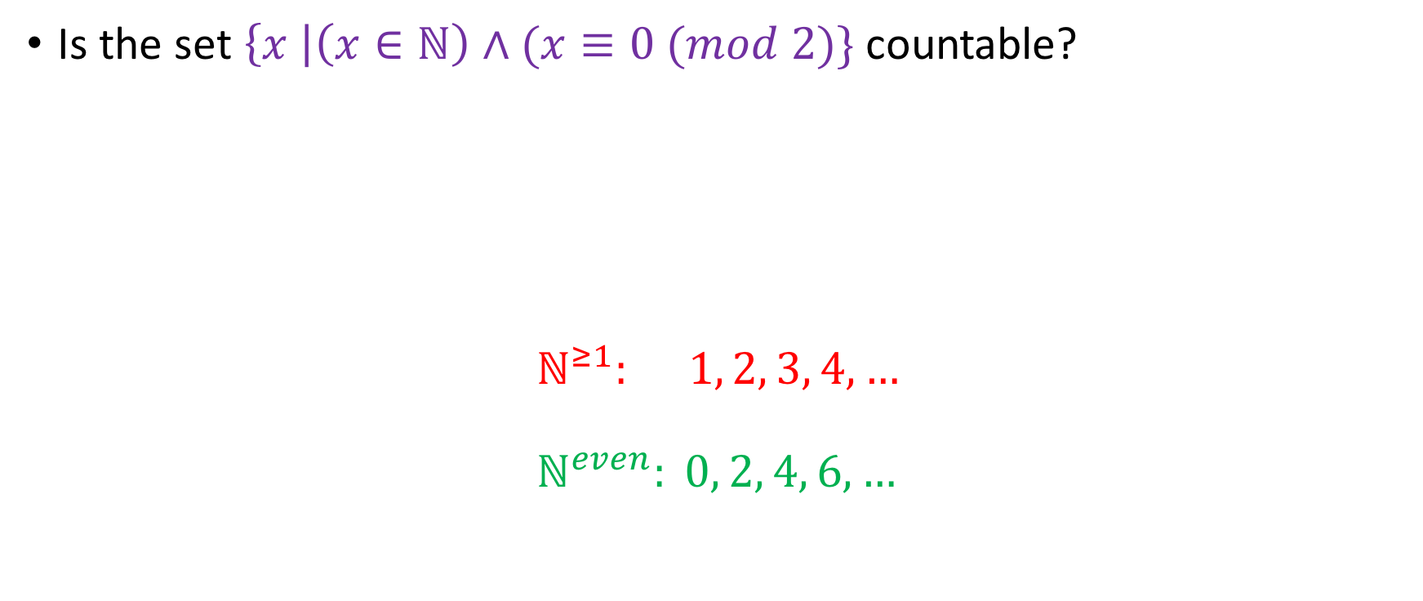

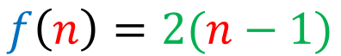
Countability of other $A⊆ℕ$
Is the set $\left\{x \right|\left(x∈ℕ\right)∧(x≡0 (mod 2)\}$ countable?
$$ℕ^{≥1}: 1, 2, 3, 4, … \\ ℕ^{even}: 0, 2, 4, 6, …$$
Yes
No
$$f$$
$$f\left(n\right)=2(n−1)$$

Slide 35
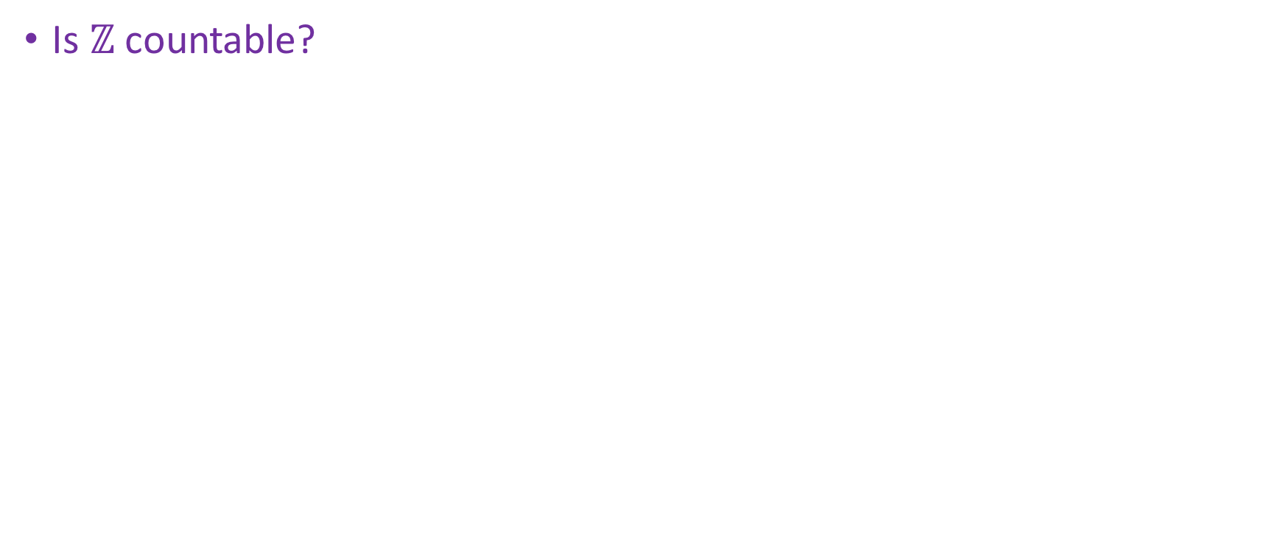

Countability of $ℤ$
Is $ℤ$ countable?
Yes
No

Slide 36
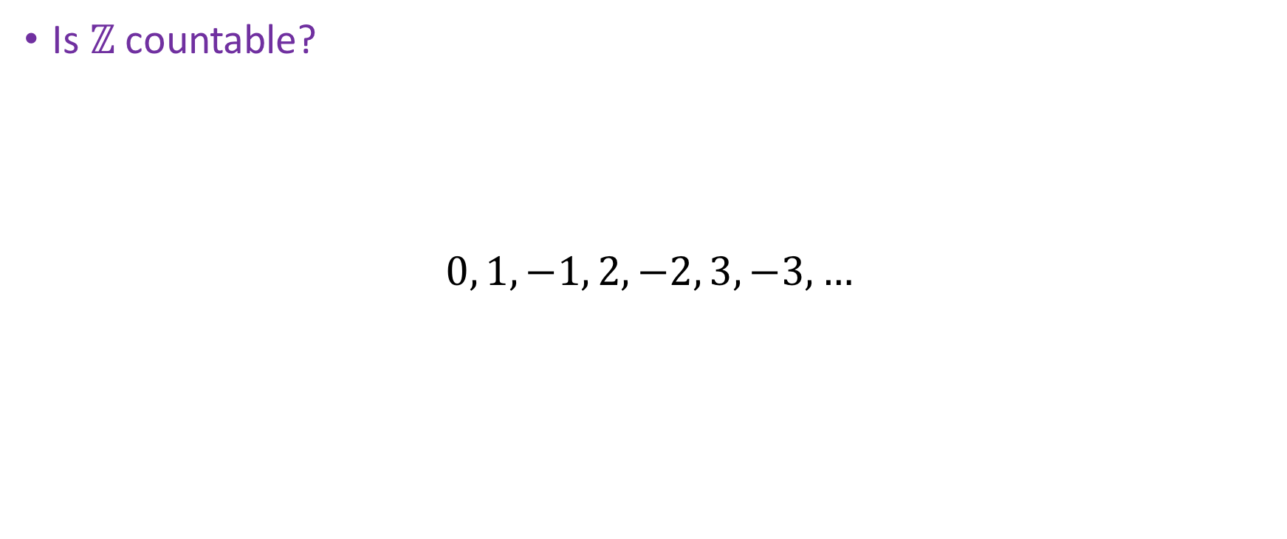
Countability of $ℤ$
Is $ℤ$ countable?
$$0, 1, −1, 2, −2, 3, −3,…$$
Yes
No
1
2
3
4
5
6
7

Slide 37
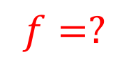
Countability of $ℤ$
Is $ℤ$ countable?
$$0, 1, −1, 2, −2, 3, −3,…$$
Yes
No
1
2
3
4
5
6
7
$$f=?$$

Slide 38
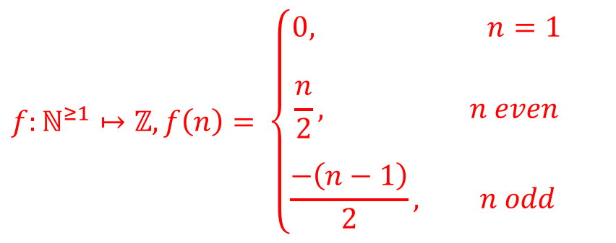
Countability of $ℤ$
Is $ℤ$ countable?
$$0, 1, −1, 2, −2, 3, −3,…$$
Yes
No
1
2
3
4
5
6
7
$$f:ℕ^{≥1}↦ℤ, f\left(n\right)= \left\{\begin{aligned}0, n=1 \\ \\ \frac{n}{2}, n even \\ \\ \frac{−\left(n−1\right)}{2}, n odd \end{aligned}\right.$$

Slide 39
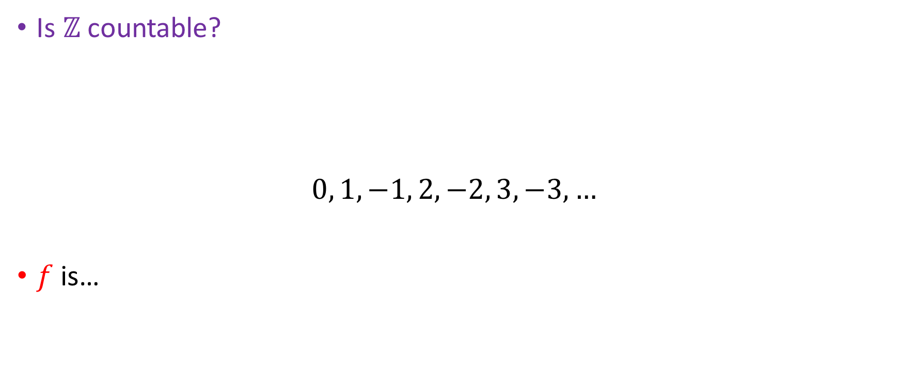
Countability of $ℤ$
Is $ℤ$ countable?
$$0, 1, −1, 2, −2, 3, −3,…$$
$f$ is…
Yes
No
1
2
3
4
5
6
7
$$f:ℕ^{≥1}↦ℤ, f\left(n\right)= \left\{\begin{aligned}0, n=1 \\ \\ \frac{n}{2}, n even \\ \\ \frac{−\left(n−1\right)}{2}, n odd \end{aligned}\right.$$

Slide 40
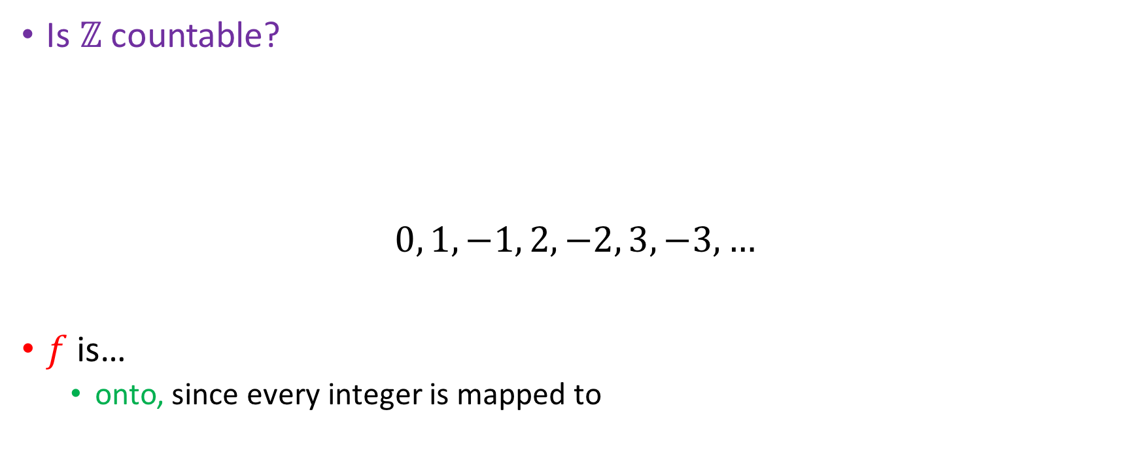
Countability of $ℤ$
Is $ℤ$ countable?
$$0, 1, −1, 2, −2, 3, −3,…$$
$f$ is…
onto, since every integer is mapped to
Yes
No
1
2
3
4
5
6
7
$$f:ℕ^{≥1}↦ℤ, f\left(n\right)= \left\{\begin{aligned}0, n=1 \\ \\ \frac{n}{2}, n even \\ \\ \frac{−\left(n−1\right)}{2}, n odd \end{aligned}\right.$$

Slide 41
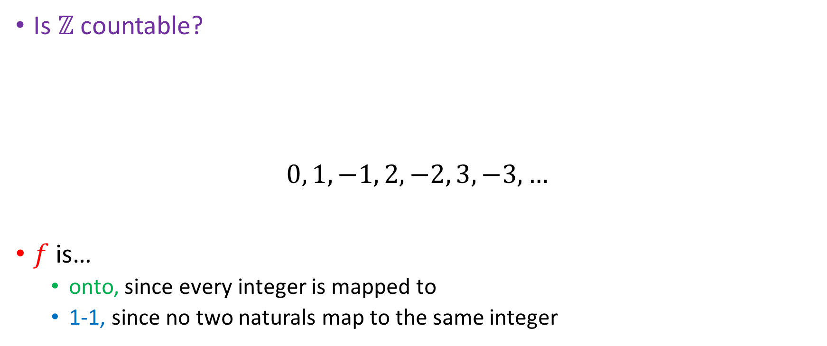
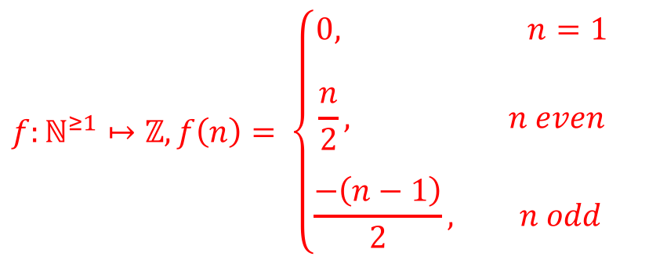
Countability of $ℤ$
Is $ℤ$ countable?
$$0, 1, −1, 2, −2, 3, −3,…$$
$f$ is…
onto, since every integer is mapped to
1-1, since no two naturals map to the same integer
Yes
No
1
3
4
5
6
7
2
$$f:ℕ^{≥1}↦ℤ, f\left(n\right)= \left\{\begin{aligned}0, n=1 \\ \\ \frac{n}{2}, n even \\ \\ \frac{−\left(n−1\right)}{2}, n odd \end{aligned}\right.$$

Slide 42
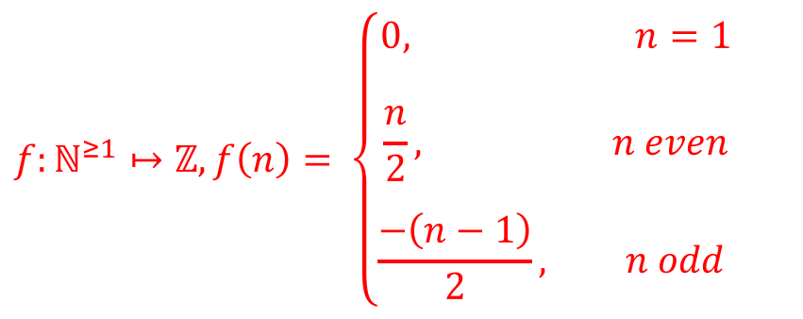
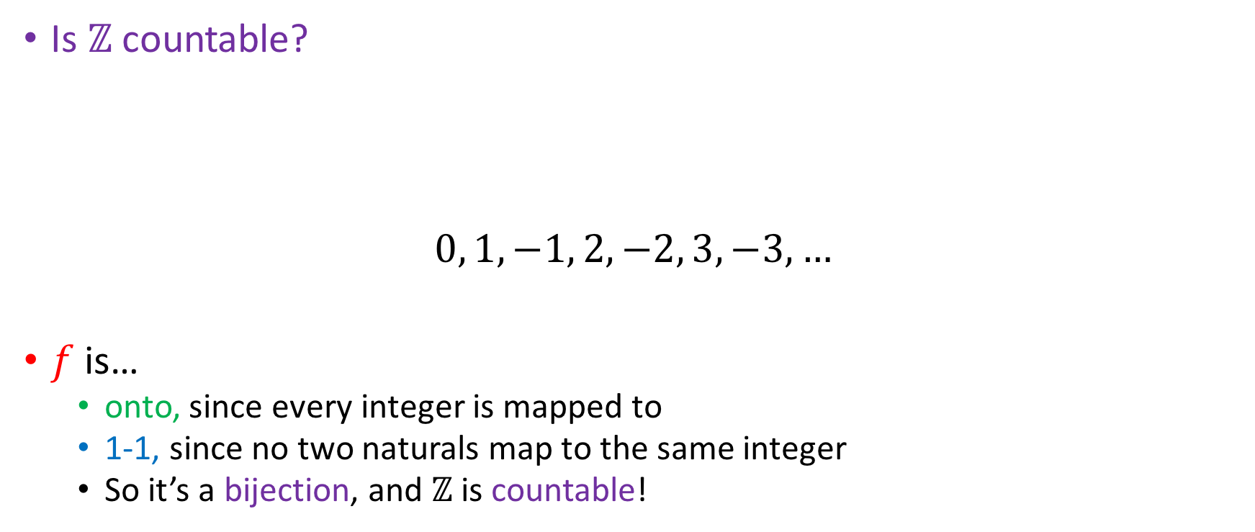
Countability of $ℤ$
Is $ℤ$ countable?
$$0, 1, −1, 2, −2, 3, −3,…$$
$f$ is…
onto, since every integer is mapped to
1-1, since no two naturals map to the same integer
So it’s a bijection, and $ℤ$ is countable!
Yes
No
1
2
3
4
5
6
7
$$f:ℕ^{≥1}↦ℤ, f\left(n\right)= \left\{\begin{aligned}0, n=1 \\ \\ \frac{n}{2}, n even \\ \\ \frac{−\left(n−1\right)}{2}, n odd \end{aligned}\right.$$

Slide 43
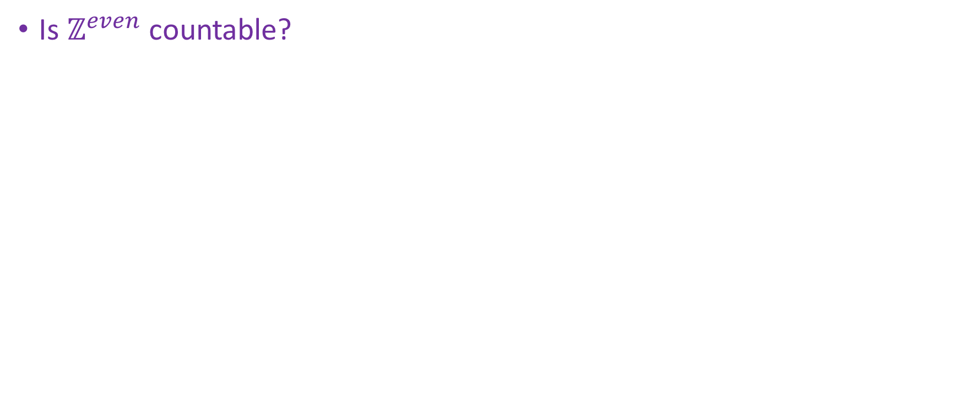

Countability of $ℤ^{even}$
Is $ℤ^{even}$ countable?
Yes
No

Slide 44

Countability of $ℤ^{even}$
Is $ℤ^{even}$ countable?
Yes
No
$$0, 2, −2, 4, −4, 6,−6…$$
1
2
3
4
5
6
7

Slide 45
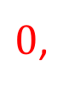
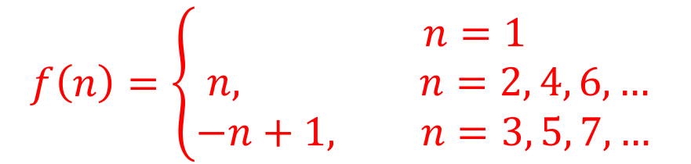
Countability of $ℤ^{even}$
Is $ℤ^{even}$ countable?
Yes
No
$$0, 2, −2, 4, −4, 6,−6…$$
1
2
3
4
5
6
7
$$f\left(n\right)=\left\{\begin{aligned} n=1 \\ n, n=2, 4, 6, … \\ −n+1, n=3, 5, 7, … \end{aligned}\right.$$
$0$,

Slide 46
Countability of $ℤ^{even}$
Is $ℤ^{even}$ countable?
Yes
No
$$0, 2, −2, 4, −4, 6,−6…$$
1
2
3
4
5
6
7
$$f\left(n\right)=\left\{\begin{aligned} n=1 \\ n, n=2, 4, 6, … \\ −n+1, n=3, 5, 7, … \end{aligned}\right.$$
$0$,
Both onto and 1-1

Slide 47
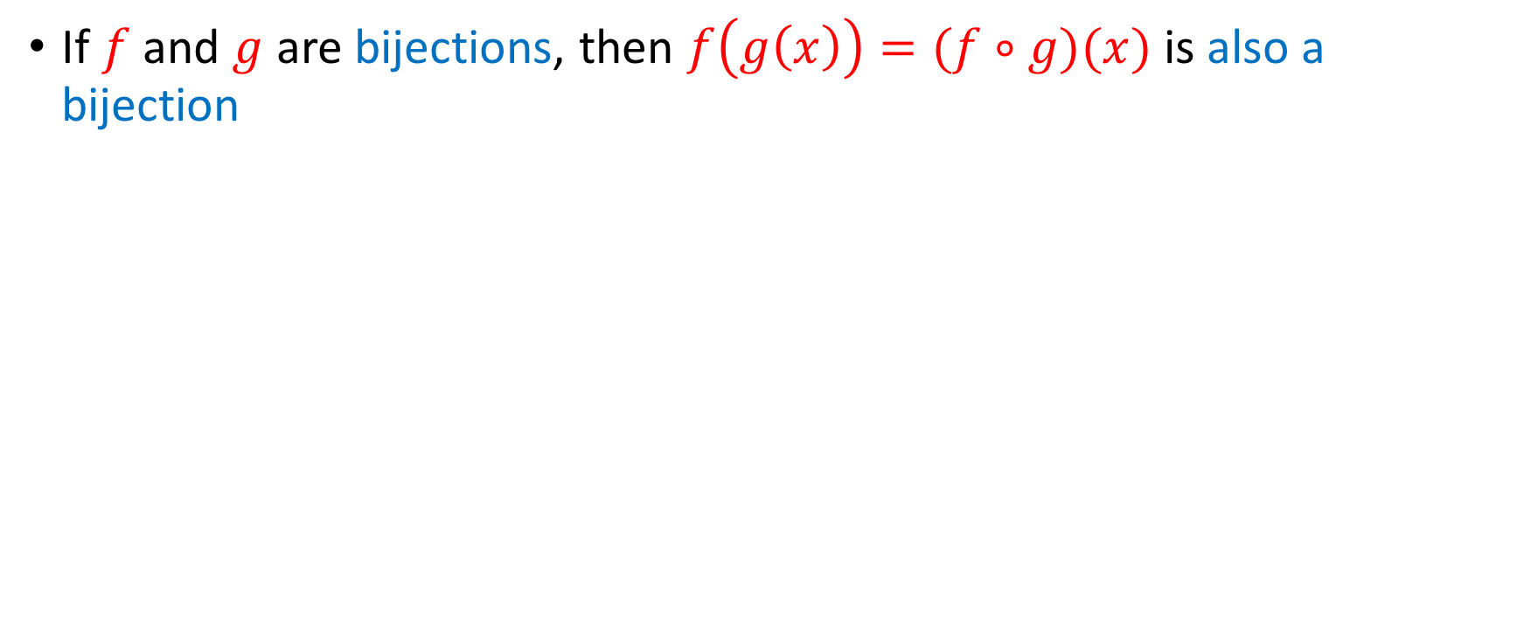
Countability of $ℤ^{even}$
If $f$ and $g$ are bijections, then $f\left(g\left(x\right)\right)=(f∘g)(x)$ is also a bijection

Slide 48
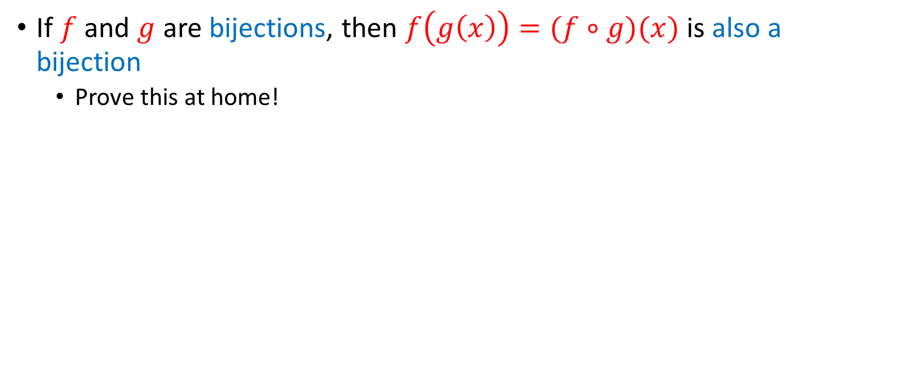
Countability of $ℤ^{even}$
If $f$ and $g$ are bijections, then $f\left(g\left(x\right)\right)=(f∘g)(x)$ is also a bijection
Prove this at home!

Slide 49
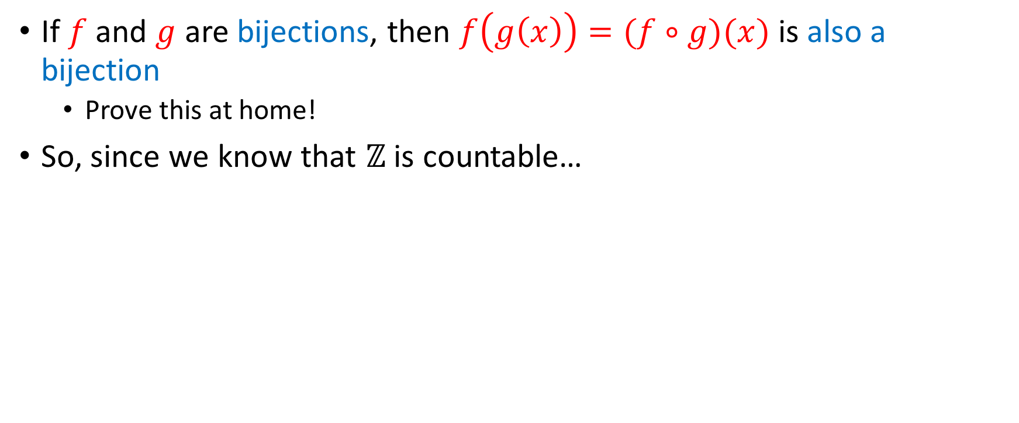
Countability of $ℤ^{even}$
If $f$ and $g$ are bijections, then $f\left(g\left(x\right)\right)=(f∘g)(x)$ is also a bijection
Prove this at home!
So, since we know that $ℤ$ is countable…

Slide 50
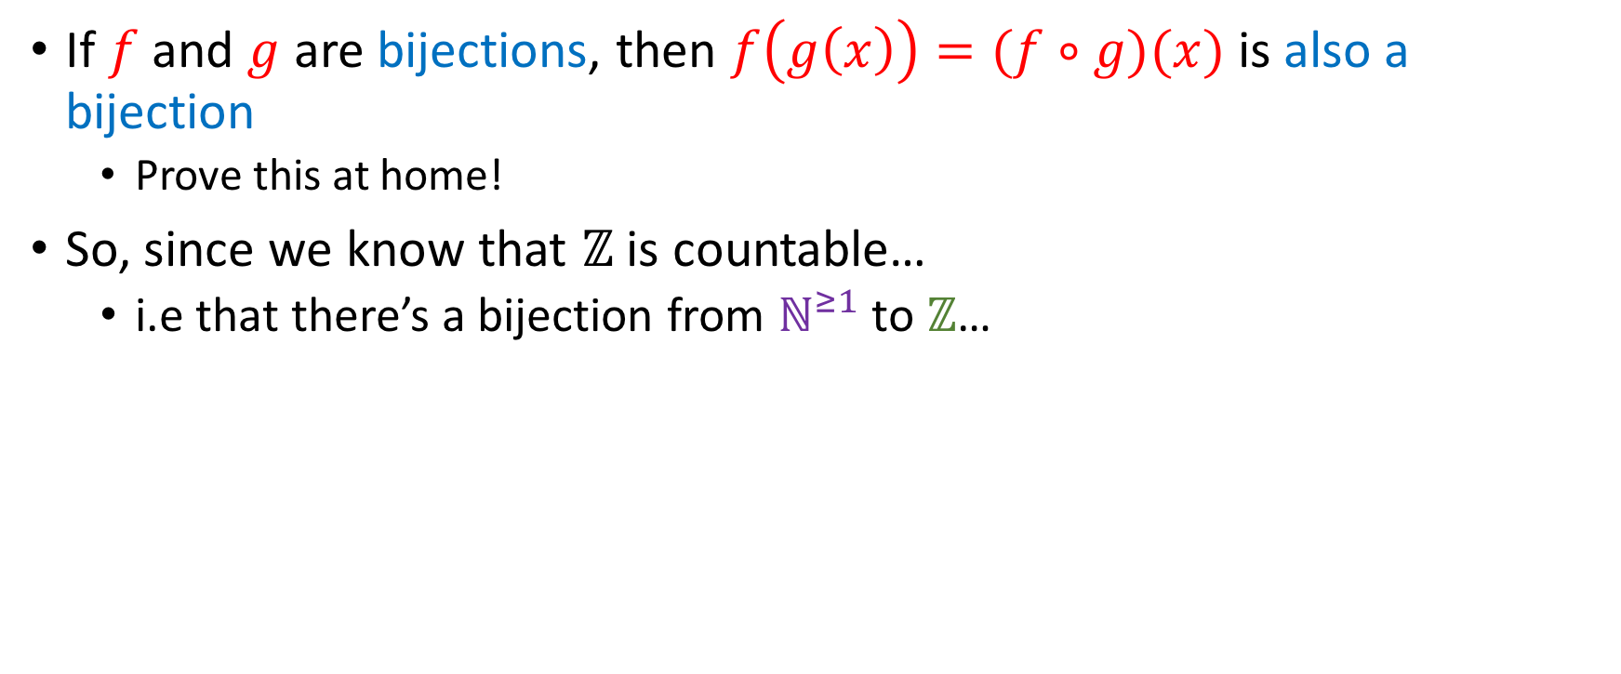
Countability of $ℤ^{even}$
If $f$ and $g$ are bijections, then $f\left(g\left(x\right)\right)=(f∘g)(x)$ is also a bijection
Prove this at home!
So, since we know that $ℤ$ is countable…
i.e that there’s a bijection from $ℕ^{≥1}$ to $ℤ$…

Slide 51
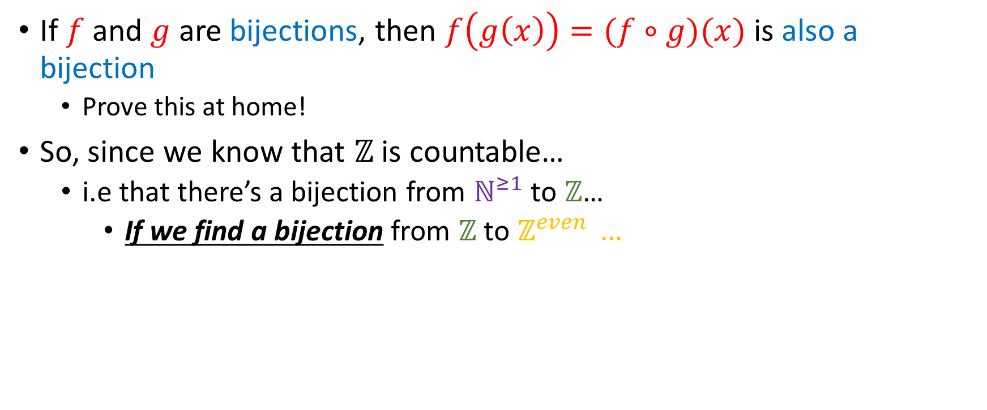
Countability of $ℤ^{even}$
If $f$ and $g$ are bijections, then $f\left(g\left(x\right)\right)=(f∘g)(x)$ is also a bijection
Prove this at home!
So, since we know that $ℤ$ is countable…
i.e that there’s a bijection from $ℕ^{≥1}$ to $ℤ$…
If we find a bijection from $ℤ$ to $ℤ^{even }…$

Slide 52
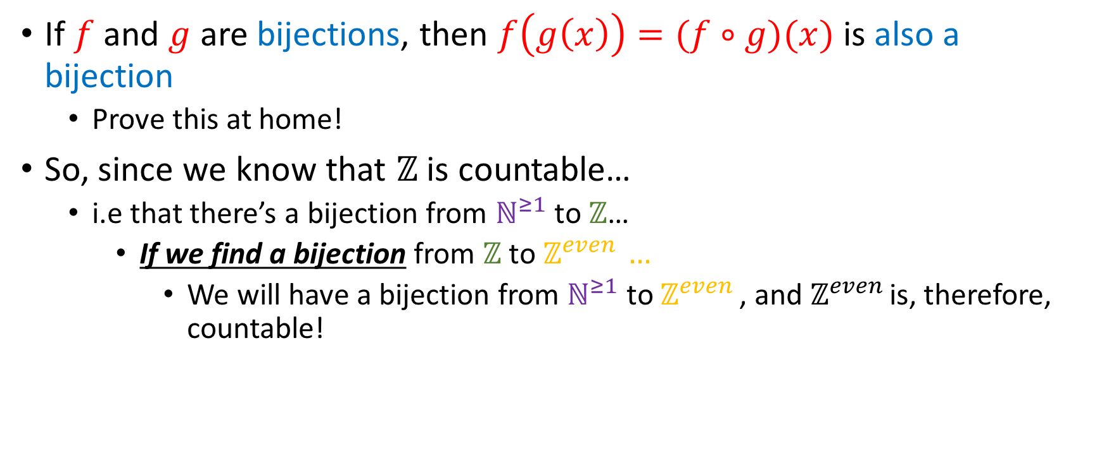
Countability of $ℤ^{even}$
If $f$ and $g$ are bijections, then $f\left(g\left(x\right)\right)=(f∘g)(x)$ is also a bijection
Prove this at home!
So, since we know that $ℤ$ is countable…
i.e that there’s a bijection from $ℕ^{≥1}$ to $ℤ$…
If we find a bijection from $ℤ$ to $ℤ^{even }…$
We will have a bijection from $ℕ^{≥1}$ to $ℤ^{even }$, and $ℤ^{even }$is, therefore, countable!

Slide 53
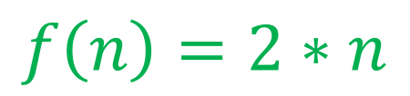


Countability of $ℤ^{even}$
If $f$ and $g$ are bijections, then $f\left(g\left(x\right)\right)=(f∘g)(x)$ is also a bijection
Prove this at home!
So, since we know that $ℤ$ is countable…
i.e that there’s a bijection from $ℕ^{≥1}$ to $ℤ$…
If we find a bijection from $ℤ$ to $ℤ^{even }…$
We will have a bijection from $ℕ^{≥1}$ to $ℤ^{even }$, and $ℤ^{even }$is, therefore, countable!
$$f\left(n\right)=2∗n$$
$$…,−6, −4 , −2, 0, 2, 4, 6,…$$
$$…,−3, −2 , −1, 0, 1, 2, 3,…$$

Slide 54
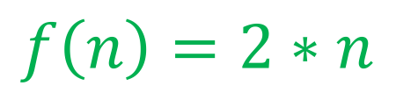
Countability of $ℤ^{even}$
If $f$ and $g$ are bijections, then $f\left(g\left(x\right)\right)=(f∘g)(x)$ is also a bijection
Prove this at home!
So, since we know that $ℤ$ is countable…
i.e that there’s a bijection from $ℕ^{≥1}$ to $ℤ$…
If we find a bijection from $ℤ$ to $ℤ^{even }…$
We will have a bijection from $ℕ^{≥1}$ to $ℤ^{even }$, and $ℤ^{even }$is, therefore, countable!
$$…,−6, −4 , −2, 0, 2, 4, 6,…$$
$$f\left(n\right)=2∗n$$
$$…,−3, −2 , −1, 0, 1, 2, 3,…$$
clearly bijective

Slide 55


Countability of $ℚ^{>0}$
Is $ℚ^{>0}$ countable?
Yes
No

Slide 56

Countability of $ℚ^{>0}$
Is $ℚ^{>0}$ countable?
Yes
No

Slide 57

Countability of $ℚ^{>0}$
Is $ℚ^{>0}$ countable?
Yes
No
 | 1 | 2 | 3 | 4 | ...
1 | $$1/1$$ | $$1/2$$ | $$1/3$$ | $$1/4$$ | …
2 | $$2/1$$ | $$2/2$$ | $$2/3$$ | $$2/4$$ | …
3 | $$3/1$$ | $$3/2$$ | $$3/3$$ | $$3/4$$ | ….
4 | $$4/1$$ | $$4/2$$ | $$4/3$$ | $$4/4$$ | ….
… | … | … | …. | …. | ….

Slide 58

Countability of $ℚ^{>0}$
Is $ℚ^{>0}$ countable?
Yes
No
 | 1 | 2 | 3 | 4 | ...
1 | $$1/1$$ | $$1/2$$ | $$1/3$$ | $$1/4$$ | …
2 | $$2/1$$ | $$2/2$$ | $$2/3$$ | $$2/4$$ | …
3 | $$3/1$$ | $$3/2$$ | $$3/3$$ | $$3/4$$ | ….
4 | $$4/1$$ | $$4/2$$ | $$4/3$$ | $$4/4$$ | ….
… | … | … | …. | …. | ….
All strictly positive rationals are counted exactly once (skipping repetitions like $\frac{1}{1}=\frac{2}{2}=\frac{3}{3}=…$), so this “snaking” is a bijection

Slide 59
Countability of $ℚ^{>0}$
If you don’t like the proof involving this ”snaking” pattern, ProofWiki has 4 (!) different proofs here: http://www.homeschoolmath.net/teaching/rational-numbers-countable.php
(1) tries to prove the “snaking” pattern in a way that I don’t find very rigorous
2, 3, 4 assume other facts that we won’t prove today, but are easy to prove
E.g the cartesian product of countable sets is also countable, or the union of countable sets is also a countable set!

Slide 60

Countability of $ℚ^{>0}$
Another way to prove this fact formally is focusing on the diagonals, and realize that the $i^{th}$ diagonal has an interesting property!
$d_{i}=\{ \frac{a}{b} | \left(a,i ∈ℕ\right)∧\left(b∈ ℕ^{≠0}\right)∧\left(a+b\right)=i+2\}$

Slide 61
Countability of $ℚ^{>0}$
Another way to prove this fact formally is focusing on the diagonals, and realize that the $i^{th}$ diagonal has an interesting property!
$d_{i}=\{ \frac{a}{b} | \left(a,i ∈ℕ\right)∧\left(b∈ ℕ^{≠0}\right)∧\left(a+b\right)=i+2\}$
Because of zero indexing

Slide 62

Countability of $ℚ^{>0}$
Another way to prove this fact formally is focusing on the diagonals, and realize that the $i^{th}$ diagonal has an interesting property!
$d_{i}=\{ \frac{a}{b} | \left(a,i ∈ℕ\right)∧\left(b∈ ℕ^{≠0}\right)∧\left(a+b\right)=i+2\}$
If we can prove that:
Because of zero indexing

Slide 63

Countability of $ℚ^{>0}$
Another way to prove this fact formally is focusing on the diagonals, and realize that the $i^{th}$ diagonal has an interesting property!
$d_{i}=\{ \frac{a}{b} | \left(a,i ∈ℕ\right)∧\left(b∈ ℕ^{≠0}\right)∧\left(a+b\right)=i+2\}$
If we can prove that:
$\left(∀i∈ℕ\right)[d_{i}$ is countable]
The union of countable sets is also countable
We then have:
$d_{0}∪d_{1}∪d_{2}∪…=\bigcup_{i=0}^{+∞}{d_{i} }=ℚ^{>0}$ is countable!
Because of zero indexing

Slide 64

Some theorems on countability
Suppose $A$ is a countable set and $e∉A$. Is $A∪\{e\}$ countable?
Yes
No
Unknown to science

Slide 65

Some theorems on countability
Suppose $A$ is a countable set and $e∉A$. Is $A∪\{e\}$ countable?
Suppose $a_{1},a_{2},a_{3},$… is an enumeration of A.
We then define a new enumeration $b$ of $A∪\{e\}$, like so:
$$b_{n}=\left\{\begin{aligned}e, n=1 \\ a_{n−1}, n≥2\end{aligned}\right.$$
Yes
No
Unknown to science

Slide 66

Some theorems on countability
Suppose $A$ is a countable set and $e∉A$. Is $A∪\{e\}$ countable?
Suppose $a_{1},a_{2},a_{3},$… is an enumeration of A.
We then define a new enumeration $b$ of $A∪\{e\}$, like so:
$$b_{n}=\left\{\begin{aligned}e, n=1 \\ a_{n−1}, n≥2\end{aligned}\right.$$
Yes
No
Unknown to science
Pretty much like in the case of $ℕ$, we just “move one index over”!

Slide 67

Some theorems on countability
Suppose $A$ and $B$ are countable sets. Is $A∪B$ countable?
Yes
No
Unknown to science

Slide 68


Some theorems on countability
Suppose $A$ and $B$ are countable sets. Is $A∪B$ countable?
For simplicity, assume $A$ and $B$ are countably infinite.
1, 2, 3, 4, ….
$a_{1}, b_{1}, a_{2}, b_{2}$…
Yes
No
Unknown to science
$$f$$

Slide 69

Some theorems on countability
Suppose $A$ and $B$ are countable sets. Is $A∪B$ countable?
For simplicity, assume $A$ and $B$ are countably infinite.
1, 2, 3, 4, ….
$a_{1}, b_{1}, a_{2}, b_{2}$…
Yes
No
Unknown to science
$$f\left(n\right)=\left\{\begin{aligned}a_{{(n+1)}/2, n odd} \\ b_{n/2}, n even\end{aligned}\right.$$
$$f$$

Slide 70

What if A or B (or both) finite?
Caveat: the previous will not work if A or B end before the other ends.
Because some $a_{i}, b_{i}$ might not exist.
We leave it to you to iron out the details of what happens then.

Slide 71


Note: $A∪B∪C$ countable
If $A, B, C$ are countable, so is $A∪B∪C$.
Since $A, B$ are countable, $\left(A∪ B\right)=S_{1}$ is countable
$\left(A∪ B\right)∪ C=S_{1}∪ C.$ Since $S_{1}, C$ are countable, $S_{1}∪ C=\left(A∪ B\right)∪ C$ is countable.

Slide 72

Note: $A∪B∪C$ countable
If $A, B, C$ are countable, so is $A∪B∪C$.
Since $A, B$ are countable, $\left(A∪ B\right)=S_{1}$ is countable
$\left(A∪ B\right)∪ C=S_{1}∪ C.$ Since $S_{1}, C$ are countable, $S_{1}∪ C=\left(A∪ B\right)∪ C$ is countable.
Generally,
$A_{1},A_{2},A_{3},…A_{n}$ countable $⇒\bigcup_{i=1}^{n}{A_{i}}$ countable
(Countable union of countable sets is countable)

Slide 73

Note: $A∪B∪C$ countable
If $A, B, C$ are countable, so is $A∪B∪C$.
Since $A, B$ are countable, $\left(A∪ B\right)=S_{1}$ is countable
$\left(A∪ B\right)∪ C=S_{1}∪ C.$ Since $S_{1}, C$ are countable, $S_{1}∪ C=\left(A∪ B\right)∪ C$ is countable.
Generally,
$A_{1},A_{2},A_{3},…A_{n,}A_{n+1},…$ countable $⇒\bigcup_{i=1}^{+∞}{A_{i}}$ countable
(Countable union of countable sets is countable)
Proof on next slide!

Slide 74

Countable union of countable sets countable
Here’s a proof that uses the snaking patern.
Suppose $A_{i}=\{a_{i_{j}}, j∈ℕ\}$. Then, we can arrange the elements of the $A_{i}$’th set in the $i^{th}$ row of a 2D matrix:

Slide 75


Countable union of countable sets countable
Here’s another proof that uses the snaking patern.
Suppose $A_{i}=\{a_{i_{j}}, j∈ℕ\}$. Then, we can arrange the elements of the $A_{i}$’th set in the $i^{th}$ row of a 2D matrix:
 | 1st element | 2nd element | 3rd element | 4th element | $$…$$
$$A_{1}$$ | $$a_{1_{1}}$$ | $$a_{1_{2}}$$ | $$a_{1_{3}}$$ | $${a_{1}}_{4}$$ | $$…$$
$$A_{2}$$ | $${a_{2}}_{1}$$ | $${a_{2}}_{2}$$ | $${a_{2}}_{3}$$ | $${a_{2}}_{4}$$ | $$…$$
$$A_{3}$$ | $${a_{3}}_{1}$$ | $${a_{3}}_{2}$$ | $${a_{3}}_{3}$$ | $${a_{3}}_{4}$$ | $$…$$
$$A_{4}$$ | $${a_{4}}_{1}$$ | $${a_{4}}_{2}$$ | $${a_{4}}_{3}$$ | $${a_{4}}_{4}$$ | $$…$$
$$⋮$$ | $$⋮$$ | $$⋮$$ | $$⋮$$ | $$⋮$$ | $$⋱$$

Slide 76

Countable union of countable sets countable
Here’s another proof that uses the snaking patern.
Suppose $A_{i}=\{a_{i_{j}}, j∈ℕ\}$. Then, we can arrange the elements of the $A_{i}$’th set in the $i^{th}$ row of a 2D matrix:
 | 1st element | 2nd element | 3rd element | 4th element | $$…$$
$$A_{1}$$ | $$a_{1_{1}}$$ | $$a_{1_{2}}$$ | $$a_{1_{3}}$$ | $${a_{1}}_{4}$$ | $$…$$
$$A_{2}$$ | $${a_{2}}_{1}$$ | $${a_{2}}_{2}$$ | $${a_{2}}_{3}$$ | $${a_{2}}_{4}$$ | $$…$$
$$A_{3}$$ | $${a_{3}}_{1}$$ | $${a_{3}}_{2}$$ | $${a_{3}}_{3}$$ | $${a_{3}}_{4}$$ | $$…$$
$$A_{4}$$ | $${a_{4}}_{1}$$ | $${a_{4}}_{2}$$ | $${a_{4}}_{3}$$ | $${a_{4}}_{4}$$ | $$…$$
$$⋮$$ | $$⋮$$ | $$⋮$$ | $$⋮$$ | $$⋮$$ | $$⋱$$
Snake ‘em!

Slide 77

Some theorems on countability
Suppose $A$ and $B$ are countable sets. Is $A × B$ countable?
Yes
No
Unknown to science

Slide 78

Some theorems on countability
Suppose $A$ and $B$ are countable sets. Is $A × B$ countable?
Proof is exactly the same as the proof that $ℚ^{>0}$ is countable!
Yes
No
Unknown to science

Slide 79

Some theorems on countability
Suppose $A$ and $B$ are countable sets. Is $A × B$ countable?
Proof is exactly the same as the proof that $ℚ^{>0}$ is countable!
Yes
No
Unknown to science
 | $$b_{1}$$ | $$b_{2}$$ | $$b_{3}$$ | $$b_{4}$$ | ...
$$a_{1}$$ | $$(a_{1}, b_{1})$$ | $$(a_{1}, b_{2})$$ | $${(a}_{1}, b_{3})$$ | $$(a_{1},b_{4})$$ | …
$$a_{2}$$ | $$(a_{2},b_{1})$$ | $$(a_{2},b_{2})$$ | $$(a_{2},b_{3})$$ | $$(a_{2}, b_{4})$$ | …
$$a_{3}$$ | $$(a_{3}, b_{1})$$ | $$(a_{3}, b_{2})$$ | $$(a_{3}, b_{3})$$ | $${(a}_{3}, b_{4})$$ | ….

Slide 80

Some theorems on countability
Suppose $A$ and $B$ are countable sets. Is $A × B$ countable?
Proof is exactly the same as the proof that $ℚ^{>0}$ is countable!
Yes
No
Unknown to science
 | $$b_{1}$$ | $$b_{2}$$ | $$b_{3}$$ | $$b_{4}$$ | ...
$$a_{1}$$ | $$(a_{1}, b_{1})$$ | $$(a_{1}, b_{2})$$ | $${(a}_{1}, b_{3})$$ | $$(a_{1},b_{4})$$ | …
$$a_{2}$$ | $$(a_{2},b_{1})$$ | $$(a_{2},b_{2})$$ | $$(a_{2},b_{3})$$ | $$(a_{2}, b_{4})$$ | …
$$a_{3}$$ | $$(a_{3}, b_{1})$$ | $$(a_{3}, b_{2})$$ | $$(a_{3}, b_{3})$$ | $${(a}_{3}, b_{4})$$ | ….

Slide 81


Countability of $ℝ$
Is $ℝ$ countable?
Yes
No
Unknown to science

Slide 82

Countability of $ℝ$
Is $ℝ$ countable?
Yes
No
Unknown to science

Slide 83

Countability of $ℝ$
Is $ℝ$ countable?
Cantor’s famous diagonal argument!
Yes
No
Unknown to science

Slide 84

Countability of $ℝ$
Is $ℝ$ countable?
Cantor’s famous diagonal argument!
The argument actually proves that the interval [0,1] is uncountable, but the result generalizes to the entirety of $ℝ$
Yes
No
Unknown to science

Slide 85

Cantor’s diagonal argument
Proof by contradiction: Suppose that $[0, 1]$is countable. Then, there exists some bijection from $ℕ^{≥1}$ to $[0, 1]$, i.e the reals can be enumerated in a sequence:
0.28422856231…..
0.28422856232…..
0.28922856233…..
………………….………..
………………….………..
$n$. 0.28422856001……

Slide 86


Cantor’s diagonal argument
$$r_{1}=0.28422856231…$$
$$r_{2}= 0.28422856232…$$
$$r_{3}= 0.28922856233…$$
$⋮$ = ………………….………..
$⋮$ = ………………….………..
$$r_{n}= 0.28422856001…$$
Let’s create the real number $r=0.a_{1}a_{2}a_{3}…a_{n}…$ where
$$a_{i}=\left\{\begin{aligned}0, { r}_{i_{i}}=9 \\ r_{i_{i}}+1, 0≤r_{i_{i}}<9\end{aligned}\right.$$
Note: $r_{i_{i}}$ is the $i^{th}$ digit of the $i^{th}$ real.

Slide 87

Cantor’s diagonal argument
$$r_{1}=0.28422856231…$$
$$r_{2}= 0.28422856232…$$
$$r_{3}= 0.28922856233…$$
$⋮$ = ………………….………..
$⋮$ = ………………….………..
$$r_{n}= 0.28422856001…$$
Let’s create the real number $r=0.a_{1}a_{2}a_{3}…a_{n}…$ where
$$a_{i}=\left\{\begin{aligned}0, { r}_{i_{i}}=9 \\ r_{i_{i}}+1, 0≤r_{i_{i}}<9\end{aligned}\right.$$
In this example,$r=0.$
Note: $r_{i_{i}}$ is the $i^{th}$ digit of the $i^{th}$ real.

Slide 88

Cantor’s diagonal argument
$$r_{1}=0.28422856231…$$
$$r_{2}= 0.28422856232…$$
$$r_{3}= 0.28922856233…$$
$⋮$ = ………………….………..
$⋮$ = ………………….………..
$$r_{n}= 0.28422856001…$$
Let’s create the real number $r=0.a_{1}a_{2}a_{3}…a_{n}…$ where
$$a_{i}=\left\{\begin{aligned}0, { r}_{i_{i}}=9 \\ r_{i_{i}}+1, 0≤r_{i_{i}}<9\end{aligned}\right.$$
In this example,$r=0.$3
Note: $r_{i_{i}}$ is the $i^{th}$ digit of the $i^{th}$ real.

Slide 89
Cantor’s diagonal argument
$$r_{1}=0.28422856231…$$
$$r_{2}= 0.28422856232…$$
$$r_{3}= 0.28922856233…$$
$⋮$ = ………………….………..
$⋮$ = ………………….………..
$$r_{n}= 0.28422856001…$$
Let’s create the real number $r=0.a_{1}a_{2}a_{3}…a_{n}…$ where
$$a_{i}=\left\{\begin{aligned}0, { r}_{i_{i}}=9 \\ r_{i_{i}}+1, 0≤r_{i_{i}}<9\end{aligned}\right.$$
In this example,$r=0.$3
Note: $r_{i_{i}}$ is the $i^{th}$ digit of the $i^{th}$ real.
First digit yielded by the application of the second rule…

Slide 90

Cantor’s diagonal argument
$$r_{1}=0.28422856231…$$
$$r_{2}= 0.28422856232…$$
$$r_{3}= 0.28922856233…$$
$⋮$ = ………………….………..
$⋮$ = ………………….………..
$$r_{n}= 0.28422856001…$$
Let’s create the real number $r=0.a_{1}a_{2}a_{3}…a_{n}…$ where
$$a_{i}=\left\{\begin{aligned}0, { r}_{i_{i}}=9 \\ r_{i_{i}}+1, 0≤r_{i_{i}}<9\end{aligned}\right.$$
In this example,$r=0.$39
Note: $r_{i_{i}}$ is the $i^{th}$ digit of the $i^{th}$ real.

Slide 91
Cantor’s diagonal argument
$$r_{1}=0.28422856231…$$
$$r_{2}= 0.28422856232…$$
$$r_{3}= 0.28922856233…$$
$⋮$ = ………………….………..
$⋮$ = ………………….………..
$$r_{n}= 0.28422856001…$$
Let’s create the real number $r=0.a_{1}a_{2}a_{3}…a_{n}…$ where
$$a_{i}=\left\{\begin{aligned}0, { r}_{i_{i}}=9 \\ r_{i_{i}}+1, 0≤r_{i_{i}}<9\end{aligned}\right.$$
In this example,$r=0.$39
Note: $r_{i_{i}}$ is the $i^{th}$ digit of the $i^{th}$ real.
Second digit yielded by second rule again!

Slide 92

Cantor’s diagonal argument
$$r_{1}=0.28422856231…$$
$$r_{2}= 0.28422856232…$$
$$r_{3}= 0.28922856233…$$
$⋮$ = ………………….………..
$⋮$ = ………………….………..
$$r_{n}= 0.28422856001…$$
Let’s create the real number $r=0.a_{1}a_{2}a_{3}…a_{n}…$ where
$$a_{i}=\left\{\begin{aligned}0, { r}_{i_{i}}=9 \\ r_{i_{i}}+1, 0≤r_{i_{i}}<9\end{aligned}\right.$$
In this example,$r=0.$390
Note: $r_{i_{i}}$ is the $i^{th}$ digit of the $i^{th}$ real.

Slide 93

Cantor’s diagonal argument
$$r_{1}=0.28422856231…$$
$$r_{2}= 0.28422856232…$$
$$r_{3}= 0.28922856233…$$
$⋮$ = ………………….………..
$⋮$ = ………………….………..
$$r_{n}= 0.28422856001…$$
Let’s create the real number $r=0.a_{1}a_{2}a_{3}…a_{n}…$ where
$$a_{i}=\left\{\begin{aligned}0, { r}_{i_{i}}=9 \\ r_{i_{i}}+1, 0≤r_{i_{i}}<9\end{aligned}\right.$$
In this example,$r=0.$390
Note: $r_{i_{i}}$ is the $i^{th}$ digit of the $i^{th}$ real.
This time we have to use the first rule, since $r_{3_{3}}=9$.

Slide 94

Cantor’s diagonal argument
$$r_{1}=0.28422856231…$$
$$r_{2}= 0.28422856232…$$
$$r_{3}= 0.28922856233…$$
$⋮$ = ………………….………..
$⋮$ = ………………….………..
$$r_{n}= 0.28422856001…$$
Let’s create the real number $r=0.a_{1}a_{2}a_{3}…a_{n}…$ where
$$a_{i}=\left\{\begin{aligned}0, { r}_{i_{i}}=9 \\ r_{i_{i}}+1, 0≤r_{i_{i}}<9\end{aligned}\right.$$
In this example,$r=0.$390
The proof moves diagonally, hence the term “diagonal” argument!
Note: $r_{i_{i}}$ is the $i^{th}$ digit of the $i^{th}$ real.

Slide 95

Cantor’s diagonal argument
$$r_{1}=0.28422856231…$$
$$r_{2}= 0.28422856232…$$
$$r_{3}= 0.28922856233…$$
$⋮$ = ………………….………..
$⋮$ = ………………….………..
$$r_{n}= 0.28422856001…$$
Somebody claims that $r=0.395…$ is the 17th real in the list.

Slide 96


Cantor’s diagonal argument
$$r_{1}=0.28422856231…$$
$$r_{2}= 0.28422856232…$$
$$r_{3}= 0.28922856233…$$
$⋮$ = ………………….………..
$⋮$ = ………………….………..
$$r_{n}= 0.28422856001…$$
Somebody claims that $r=0.395…$is the 17th real in the list.
But this cannot be true, since our real number was constructed such that it differs from the 17th real in the 17th decimal digit!

Slide 97

Cantor’s diagonal argument
$$r_{1}=0.28422856231…$$
$$r_{2}= 0.28422856232…$$
$$r_{3}= 0.28922856233…$$
$⋮$ = ………………….………..
$⋮$ = ………………….………..
$$r_{n}= 0.28422856001…$$
Somebody claims that $r=0.395…$ is the 17th real in the list.
But this cannot be true, since our real number was constructed such that it differs from the 17th real in the 17th decimal digit!
Generally speaking, $r$ will differ from the $i$^{th} real in the $i$^{th} digit!
So we can’t find an $k∈ℕ$ such that $0.395…=r_{k}$.
Contradiction, since we assumed we can enumerate all reals in [0,1].

Slide 98


Is $\left|ℕ\right|<\left|ℝ\right|?$
It has to be, since any given natural maps to a real, but we just proved that not all reals can be mapped to a natural!
But how can we say this rigorously?
Defn: $\left|A\right|≤|B|$ if there is an injection from $A$ into $B$
Defn: $\left|A\right|<|B|$ if there is an injection from A into B but there is no surjection from A into B!

Slide 99

More theorems on countability
Is $ℝ^{2}=ℝ × ℝ$ countable?
Yes
No
Unknown to science

Slide 100

More theorems on countability
Is $ℝ^{2}=ℝ × ℝ$ countable?
Proof: $f:ℝ↦ℝ × ℝ$ such that $f\left(x\right)=(x, 1)$ is an injection (1-1)
Hence, $ℝ × ℝ$ is at least as big as $ℝ$, and $ℝ$ is uncountable.
So , $ℝ × ℝ$ is uncountable.
Yes
No
Unknown to science

Slide 101

More theorems on countability
Is $ℂ$ (set of complex numbers) countable?
Yes
No
Unknown to science

Slide 102

More theorems on countability
Is $ℂ$ (set of complex numbers) countable?
Remember: complex numbers defined as $a+b⋅i$ for $a,b∈ℝ$.
$f:ℝ × ℝ↦ℂ$ such that $f\left(\left(a,b\right)\right)=a+b⋅i$ is a bijection from $ℝ × ℝ$ to $ℂ$
But we know that $ℝ × ℝ$ is uncountable. Therefore, $ℂ$ is uncountable.
Yes
No
Unknown to science

Slide 103

More theorems on countability
Let $A$ be any uncountable set. Is there any (infinite) $B⊆A$ that is countable?
Yes
No
Unknown to science

Slide 104

More theorems on countability
Let $A$ be any uncountable set. Is there any (infinite) $B⊆A$ that is countable?
Consider: $[0,1]$ and $\left\{\frac{1}{x} | x∈ℕ^{≥1}\right\}⊆[0,1]$
Yes
No
Unknown to science

Slide 105
More theorems on countability
Let $A$ be any uncountable set. Is there any (infinite) $B⊆A$ that is countable?
Consider: $[0,1]$ and $\left\{\frac{1}{x} | x∈ℕ^{≥1}\right\}⊆[0,1]$
Yes
No
Unknown to science
All these are positive rationals!

Slide 106

More theorems on countability
Let ${\left\{0, 1\right\}}^{∞}$ be the set of infinite bitstrings
Is it countable?
Yes
No
Unknown to science

Slide 107

More theorems on countability
Let ${\left\{0, 1\right\}}^{∞}$ be the set of infinite bitstrings
Is it countable?
Cantor-like proof in next slide!
Yes
No
Unknown to science

Slide 108

The set of infinite bit-strings is uncountable
Assume that the set is countable, then the strings can be enumerated:
1: 000111010101010…
2: 0101011110001101…
…
n: 010101000011100…
Construct bit-string $s$ which differs from the i^{th} string in the list in the i^{th} digit.
Since this string is not in the list, we can’t enumerate them all. Contradiction.

Slide 109

More theorems on countability
Let $A_{1},A_{2},A_{3}…$ be an infinite sequence of countable sets.
Is $A_{1} ×{ A}_{2} × A_{3} ×…$ countable?
Yes
No
Unknown to science

Slide 110


More theorems on countability
Let $A_{1},A_{2},A_{3}…$ be an infinite sequence of countable sets.
Is $A_{1} ×{ A}_{2} × A_{3} ×…$ countable?
Cantor-like proof in next slide!
Yes
No
Unknown to science

Slide 111

Set of infinite cartesian product of countable sets is uncountable
Notation: $a_{i}=\{a_{i_{1}},{a_{i}}_{2},a_{i_{3}}, …\}$
Suppose that the set is countable. Then, enumeration:
$$\left(a_{1_{1}, }a_{1_{2}},a_{1_{3}},a_{1_{4}},…\right), \\ \left(a_{2_{1}, }a_{2_{2}},a_{2_{3}},a_{2_{4}},…\right),$$
$$\left(a_{3_{1}, }a_{3_{2}},a_{3_{3}},a_{3_{4}},…\right),$$
…

Slide 112

Set of infinite cartesian product of countable sets is uncountable
Notation: $a_{i}=\{a_{i_{1}},{a_{i}}_{2},a_{i_{3}}, …\}$
Suppose that the set is countable. Then, enumeration:
$$\left(a_{1_{1}, }a_{1_{2}},a_{1_{3}},a_{1_{4}},…\right), \\ \left(a_{2_{1}, }a_{2_{2}},a_{2_{3}},a_{2_{4}},…\right),$$
$$\left(a_{3_{1}, }a_{3_{2}},a_{3_{3}},a_{3_{4}},…\right),$$
… Construct infinite tuple $(a_{1_{x_{1}}},a_{2_{x_{2}}}, a_{3_{x_{2}}},…)$ such that $x_{i}$ is an element of $A_{i}$
different from the element used in the i^{th} position of the i^{th} tuple!
This tuple cannot be in the list, etc etc etc

Slide 113
More reading
Epp, 7.4
Rosen, section 2.5 (Rosen presents Set Theory / Countability much earlier than Epp)
If you’re interested in finding out more about the different kinds of infinities, check out these VSauce videos:
https://www.youtube.com/watch?v=SrU9YDoXE88
https://www.youtube.com/watch?v=s86-Z-CbaHA

